Slide 1
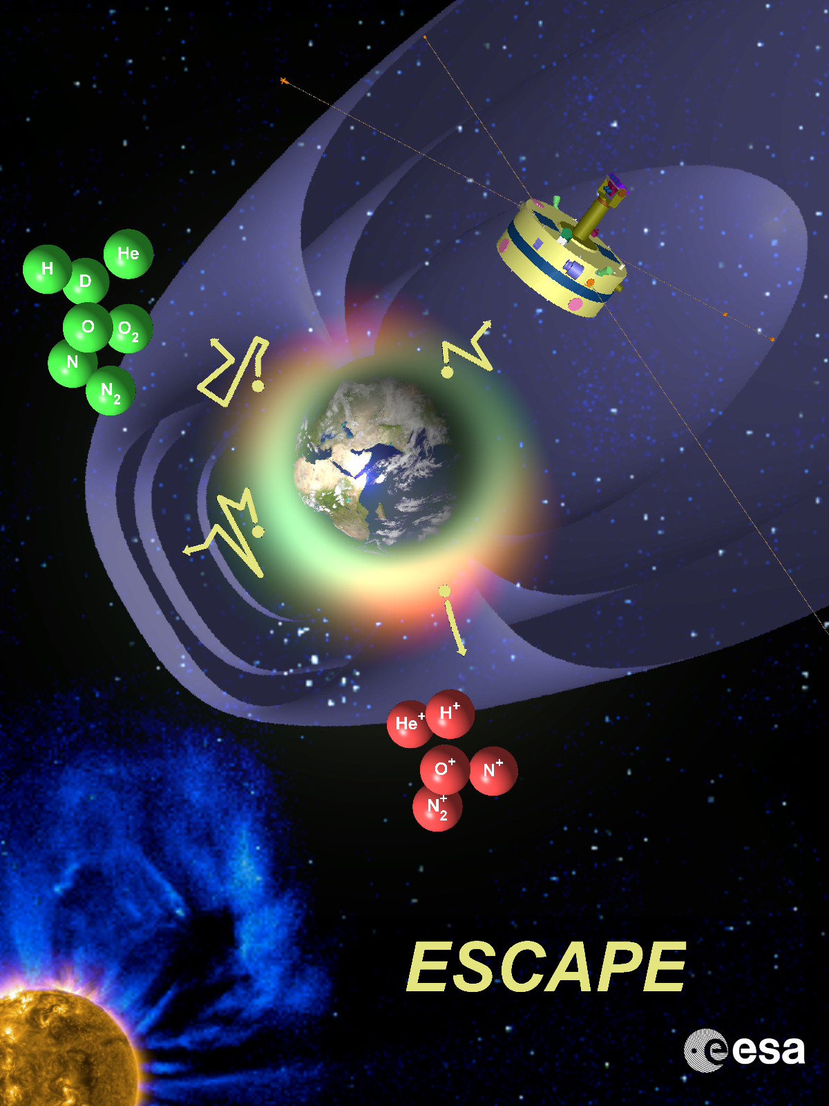
ESCAPE European SpaceCraft for the study of Atmospheric Particle Escape
How and at what rate is Earth slowly losing its atmosphere to space?
An M5 mission proposal submitted to ESA
ESCAPE Team Meeting
Bled, Slovenia 15 September 2017

Slide 2
ESCAPE : Proposal Status
ESCAPE M5 mission proposal submitted to ESA on 5 October 2016. Thanks to all for your contributions!
Proposal available at: http://cluster.irap.omp.eu/public/ESCAPE/ESCAPE_M5_Proposal_V1.1.pdf
March 2017: ESCAPE successfully passed the first technical and programmatic screening by ESA (only 12 of the M5 mission proposals submitted to ESA did it, see next slide).
Fall 2017: Evaluation by "Science Assessment Review Panel" (SARP) just started (6-months delay due to no inflation compensation for the ESA science budget).
Coming Schedule:
October 2017: Questions from SARP will be send to the Lead for all 12 Proposals (Iannis for ESCAPE). We have to answer quickly (only within 5 days for M4)
7 or 8 or 9 November 2017: Interview at ESTEC (total 1 hour for each team)
Also in November 2017: M4 mission selection will be announced. Three candidates: ARIEL : IR survey of exoplanetary atmospheres THOR : Plasma turbulence XIPE : X-ray Imaging polarimetry
December 2017 or early 2018: selection of ~3 missions for a Phase A study for M5.

Slide 3
M5 mission proposals that successfully passed the first technical and programmatic screening by ESA
- HEAVY METAL: Exploring a magnetized metallic asteroid - HERA: Saturn Entry Probe Mission - JANUS. Exploring the asymmetric magnetosphere - DEPHINE: Deimos and Phobos Interior Explorer - SELMA: Surface, Environment and Lunar Magnetic Anomalies - ENVISION: Understanding why our most Earth neighbor is so different - ESCAPE: European SpaceCraft for the study of Atmospheric Particle Escape - GALILEO Galilei (GG): a mission to test the founding pillar of General Relativity to 10-17 - CASTALIA: A mission to a Main Belt Comet - THESEUS: Transient High Energy Sky and Early Universe Surveyor - SPICA: Unveiling the obscured Universe - ALFVEN: A mission to study particle acceleration in strongly magnetized plasmas

Slide 4
ESCAPE Scientific Objectives
How and at what rate is Earth slowly losing its atmosphere to space?
1. Build a quantitative and comprehensive picture for 500-2000 km altitudes
Determine exospheric altitude density profiles and temperature profile as a function of different drivers such as solar EUV, solar wind and geomagnetic conditions.
Establish isotope ratios for both neutrals and ions and compare them with those found at the Earth's surface and in other solar system objects.
Determine exospheric altitude profiles of ion/neutral ratios and estimate ionisation / neutralisation efficiencies.
Measure temporal and spatial variations of the density of major exospheric species.
Correlate such variability with upper atmosphere parameters, and with different incident energies when particle precipitation is present.
2. Determine the dominant escape mechanisms, and their dependence on the drivers
Estimate thermal escape flux for neutral and ion species for different conditions.
Estimate the prevailing escape mechanisms and the relative importance of thermal or non-thermal escape for different driver conditions.
Estimate the response of the ionisation / neutralisation efficiencies, isotope fractionation and the N/O ratio to different drivers.
Estimate the degree of recirculation of plasma after it has left the ionosphere.

Slide 5
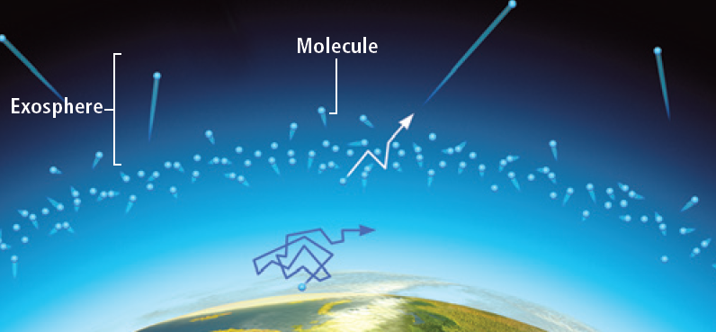
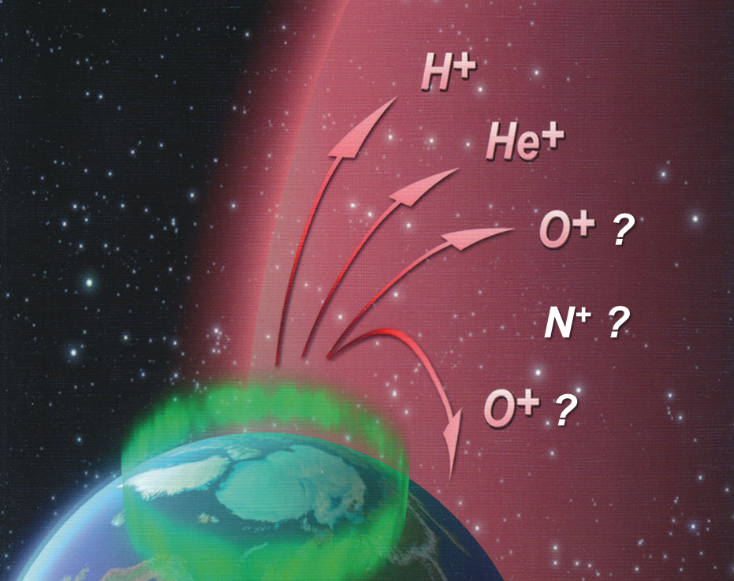
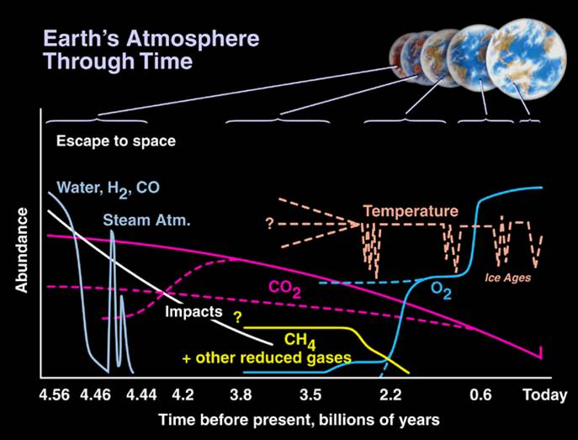
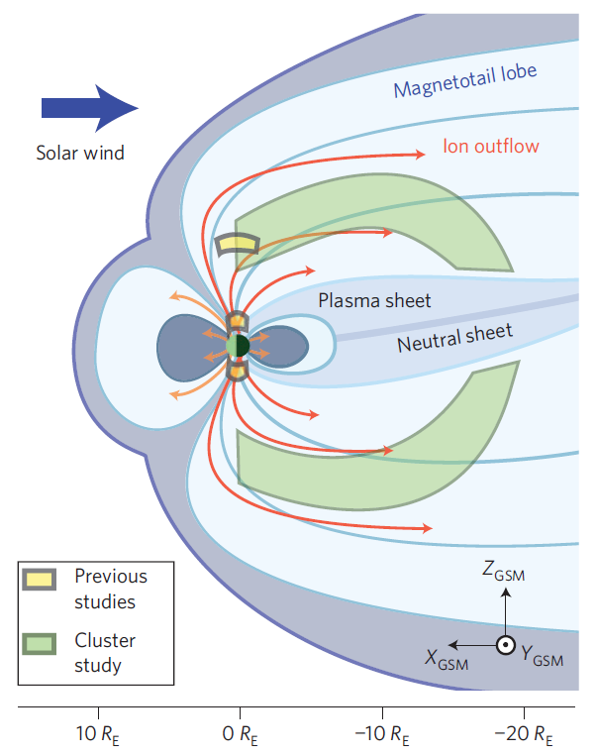
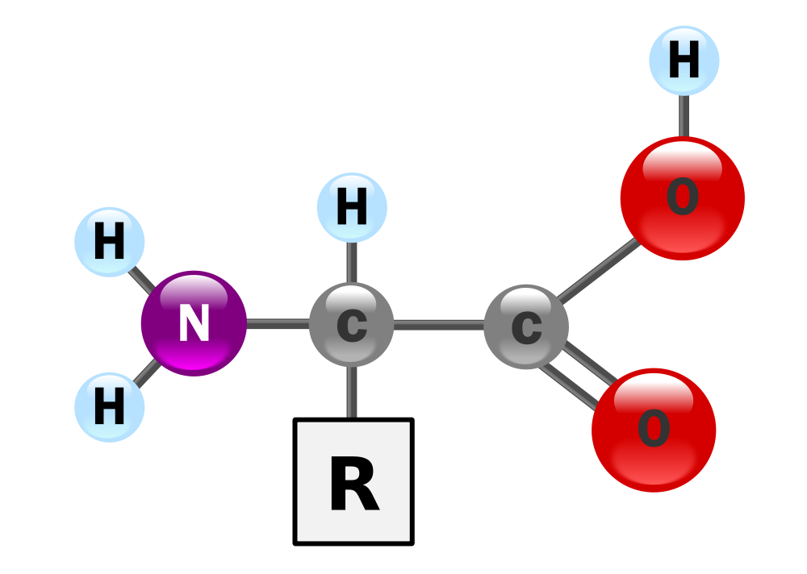
ESCAPE objectives are interdisciplinary
How and at what rate is Earth slowly losing its atmosphere
History of the Earth's atmospheric composition over a long (geological scale) time period
Implications for habitability: nitrogen & oxygen are essential elements for life
Evolution of planetary atmospheres
Magnetosphere-ionosphere coupling

Slide 6
Escape Mechanisms of Heavy Ions/Neutrals
Type / decection | Mechanism | Explanation
thermal, neutral | Jeans escape | Thermal tail exceeds the escape velocity
non-thermal, neutral | Charge exchange | Heavy (trapped) ions collide with atoms
thermal, neutral | Momentum exchange | Light neutrals collide with heavy molecules
thermal, neutral/ion | Hydrodynamic blow off | Same as solar wind formation mechanism
chemical, neutral/ion | Photochemical heating | Release of e.g. recombination energy of the excited state that accelerates the atom
thermal & non-thermal, ion | Ion pickup | Ions that are newly exposed to solar wind are removed by the solar wind ExB
non-thermal, ion | Atmospheric sputtering | The energetic ions/atoms interact with the upper atmospheric molecules/atoms/ions
non-thermal, ion | Large-scale momentum transfer & instabilities | Solar wind dynamic pressure and EM forces push the planetary plasma anti-sunward
non-thermal, ion | Ion energisation by EM waves and E// | EM disturbances / static E-fields energise ions, by e.g. the ion cyclotron resonance
non-thermal, ion | Plasmaspheric wind, plasmaspheric plumes | Plasma instabilities near the plasmapause
non-thermal, ion | Boundary shadowing | Drifting ions overshoot the magnetopause
neutrals
ions

Slide 7
Escape Mechanisms (continued)
Type | Mechanism | Where? | ∆v for same T
thermal, neutral | Jeans escape | exobase (M>E≥V) | exp()
non-thermal, neutral | Charge exchange | above mirror altitude (E) | m⁰
thermal, neutral | Momentum exchange | above exobase (M>V) | m⁰
thermal, neutral/ion | Hydrodynamic blow off | near exobase (ancient, all) | m^{-0.5} to m⁰
chemical, neutral/ion | Photochemical heating | exosphere (M>V~E) | m^{-0.5}
thermal & non-thermal, ion | Ion pickup | outer exosphere (M, V) | m⁰
non-thermal, ion | Atmospheric sputtering | around and above exobase (M, V>E) | m⁰
non-thermal, ion | Large-scale momentum transfer & instabilities | magnetospheric boundary (E>M~V) | m⁰
non-thermal, ion | Ion energisation by EM waves and E// | upper ionosphere & magnetosphere (E>M>V) | ?
non-thermal, ion | Plasmaspheric wind, plasmaspheric plumes | plasmasphere (E>M~V) | m⁰
non-thermal, ion | Boundary shadowing | ring current (E) | m⁰
neutrals
ions

Slide 8
Satellite Architecture and Orbit
Driven by Scientific Objectives
ESCAPE Orbit
Perigee: ~500 to 700 km altitude exobase: source of escaping populations
Apogee: ~33 000 km altitude inner magnetosphere: transport and injected ions
Inclination: >80° polar cap: upwelling ions; EISCAT-3D conjunctions
O⁺, N⁺
Upwelling: ~10 eV
ESCAPE s/c:
Spinning (P~20 s) ~600 km x 6.2 R_{E}
i > 80°
Exobase
Ring Current
Injected ~10 keV
ESCAPE Spacecraft
Instrumentation: in-situ & remote sensing measurements
Stabilisation: spinning, P ~20 sec: in-situ measurements 3D distributions
Equipment: despun platform; remote sensing instruments

Slide 9
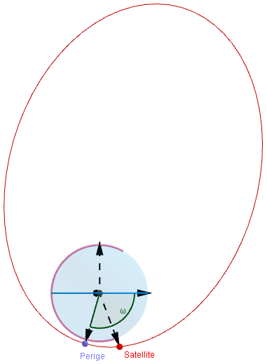
ESCAPE Orbit
Initial perigee altitude : 800 km
Apogee altitude : 33 000 km (6.2 R_{E} geocentric distance)
Orbital plane inclination : 90°
Initial latitude of the line of apsides: 85°N
Argument of perigee: 255°
It results:
Almost “inertial” orbital plane (wrt the Sun-Earth line)
9 h 45 orbital period
2697 orbits in 3 years
No need for orbit maintenance manoeuvres (unless we want to gradually change the orbit characteristics)
-0.21°/ day rotation of the line of apsides in this plane (230° in 3 years)
This latitudinal drift is in // with the longitudinal drift (wrt the magnetosphere, but fixed in inertial space)
Slow oscillation of the perigee altitude, between 800 and 480 km
Need for deorbiting at the end of mission
76.6°/ year
N
S
Initial ESCAPE orbit (red) and 1000 km altitude projection (magenta)
Due to the natural orbit evolution the orbit covers successively the northern polar cap escape route, the equatorial ring current, and then the southern polar cap escape route.

Slide 10
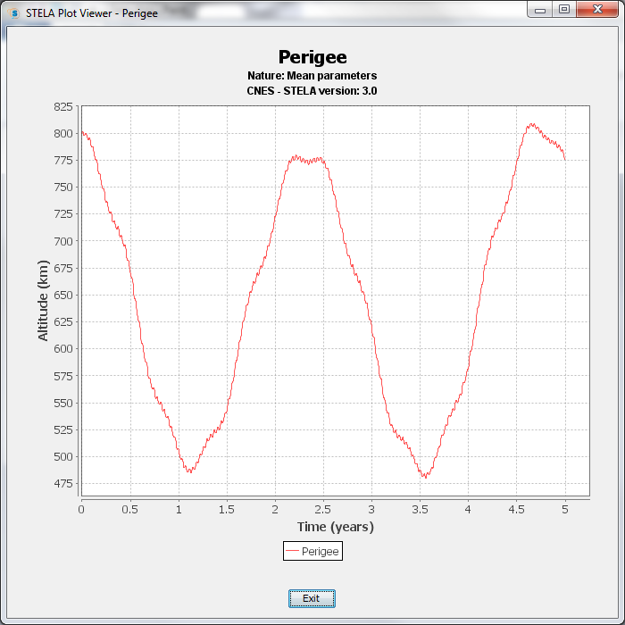
Exobase
Perigee altitude evolution
STELA (Semi-analytic Tool for End of Life Analysis) CNES software simulation

Slide 11
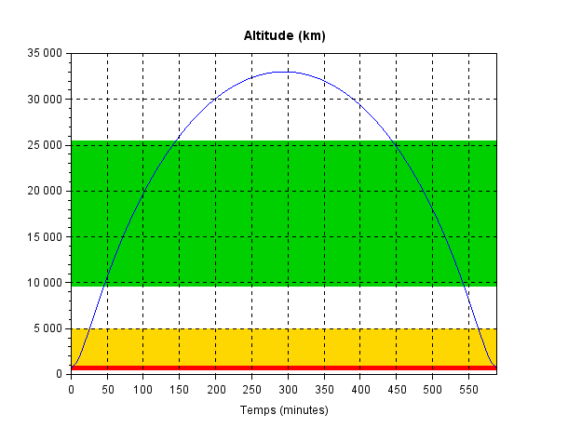
Regions of interest coverage for the in-situ measurements
Ring current region (2.5 - 5 R_{E}, lat < 45°): 34 % per orbit, i.e. > 8 hours per day
Altitude (km)
Upwelling region (1000-5000 km, lat > 70°): 1.47 % per orbit (3 yrs ave), i.e. ~21 minutes per day
Exosphere (500-1000 km): 1.56 % per orbit, i.e. ~22 minutes per day
Time (minutes) along each orbit
White and green zones, above 5000 km altitude, are perfectly suited for remote sensing observations of the lower exosphere and limb.

Slide 12
ESCAPE: Observational conditions for the remote sensing measurements
O⁺, N⁺
~5 km s⁻¹
Upwelling: ~10 eV
~1.7 km s⁻¹
Ring Current
&
Plasmasphere
Exobase
Injected ~10 keV
~9.8 km s⁻¹
Lower exosphere
Limb altitude scans
Ion upwelling regions
Middle exosphere
Plasmasphere
Altitude resolution~100km
O⁺, N⁺
Imagers provide both : remote sensing observations of escaping populations and visual support for outreach to the public

Slide 13
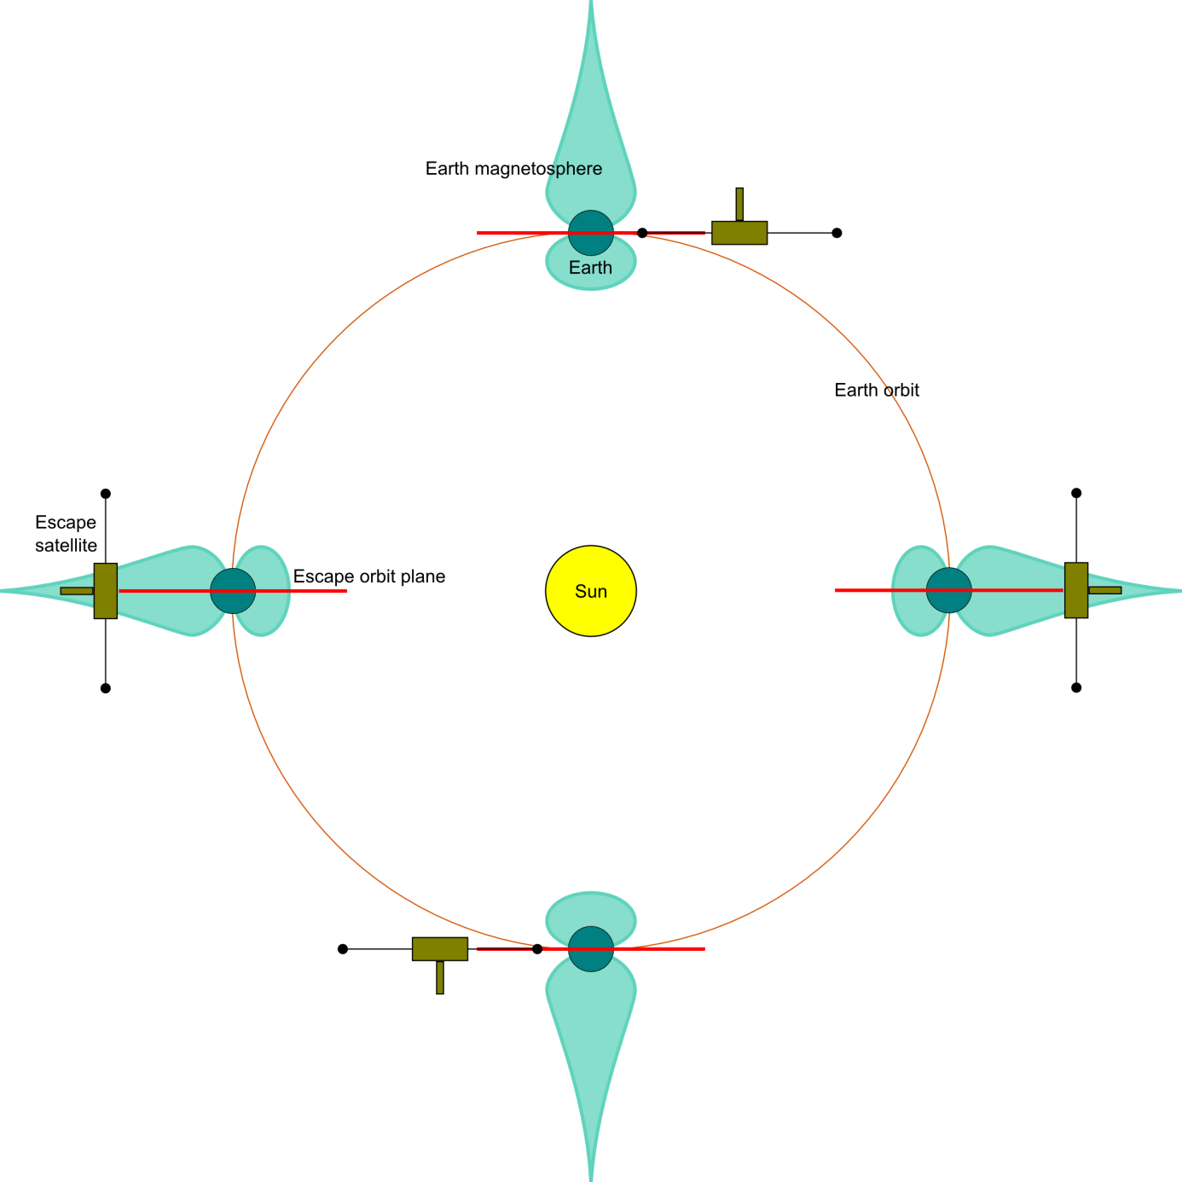
ESCAPE attitude
Requirements:
3 rotations / minute
Constant attitude with respect to the Sun
No shadows on the SLP probes
Allow auroral zone view for the inbound/outbound orbit legs
No nitrogen or CH₄ propellants
Resulting Design:
Sun-pointing spin axis
Despun platform in the shadow (UVIS & AMC FOVs never exposed to sunlight)
10°/ 10 days attitude manoeuvres (cold gas)

Slide 14
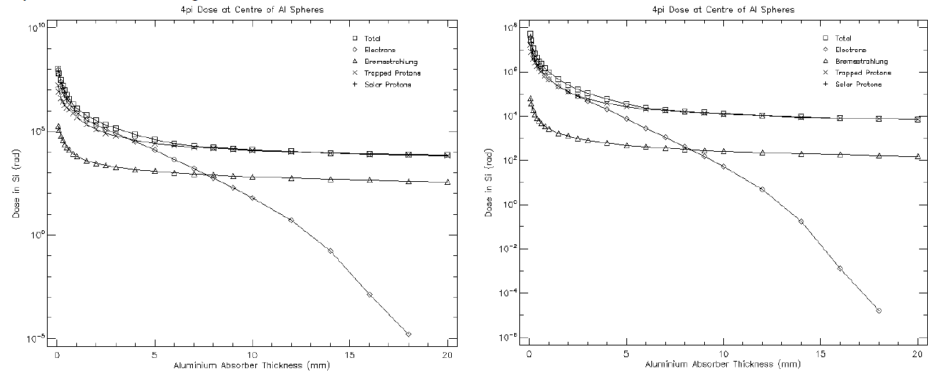
ESCAPE Orbit Total Ionising Dose
☐ Total
◇ Electrons
△ Bremsstrahlung
× Trapped Protons
+ SEPs
Dose in Si (rad)
Dose in Si (rad)
Solar Max
Solar Min
SPENVIS tool simulation
Al shielding thickness (mm)
Al shielding thickness (mm)
Total ionising dose in silicon (rad) as a function of the aluminium shielding thickness (mm) for: solar maximum (left panel) and for solar minimum (right panel)
ESCAPE will experience total ionising doses, after 3 years, of maximum ~35 – 40 krad behind 5 mm of aluminium shielding
Single events (SEUs, latch-ups) need to be considered.
During high penetrating particle rates, particle instruments DPU issues a flag.

Slide 15
What will be measured?
What to measure | Target range | Particle SI | Other SI
Density of major neutrals and cold ions, simultaneously | neutrals 1–10⁶/cc ions 0.1–10³/cc | INMS, WCIMS | UVIS, SLP ASPOC
Density of minor isotopes (neutrals and ions) | neutrals 10⁻²–10³/cc ions 10⁻⁴–10¹/cc | INMS | SLP, ASPOC
Neutrals temperatures | 500–1500 K | WCIMS | Density + model
The energy distribution of major outflow ions | 10⁵⁻⁹ keV cm⁻² s⁻¹ sr⁻¹ keV⁻¹ | MIMS, NOIA | MAG, SLP
The flux of major returning energetic ions | 10⁶⁻⁹ keV cm⁻² s⁻¹ sr⁻¹ keV⁻¹ | EMS | MAG
The energy distribution of electrons and photoelectrons | 10⁷⁻¹¹ keV cm⁻² s⁻¹ sr⁻¹ keV⁻¹ | ESMIE | MAG
Ionospheric auroral conditions | 10²⁻⁶ R |  | AMC
DC/AC field energy flux into to the ionosphere | 1–10² W/km² |  | MAG, WAVES
Electromagnetic waves associated with ions | 0.1–10³ Hz |  | MAG, WAVES
ENA flux for charge-exchanged keV ions | 10²⁻⁵ cm⁻² s⁻¹ sr⁻¹ | ENAI

Slide 16
ESCAPE: Instrumentation
In-situ measurements | TRL
INMS: Cold ion and neutral mass spectrometer (M/∆M > 1000): Univ. Bern | 7 - 8
WCIMS: Cold ions f_{dist}, neutrals (dens. & T): NASA-GSFC | 7
MIMS: Light hot ions (M < 20, ~5 eV/q – 40 keV/q): IRAP | 5
NOIA: Heavy hot ions (M > 10, 10 eV/q – 30 keV/q): IRF, Kiruna | > 6
EMS: Energetic ions (20 – 200 keV): Univ. New Hampshire, USA | > 6
ESMIE: Electrons (~5 eV – 20 keV): UCL/MSSL, London, UK | > 6
Waves (5 Hz – 20 kHz): ASCR, Prague Search Coil: LPC2E, Orléans | > 5
SLP: Sweeping Langmuir probe: e-density, E-field, spacecraft potential BIRA-IASB, Brussels | 4 - 5
MAG: Magnetic field: IWF, Graz, Austria | 8
Remote sensing measur. | TRL
UVIS: UV imaging spectrometer (85 – 140 nm; 391 nm and 428 nm): Tokyo University, Japan LATMOS, Paris | 6 - 7
AMC: Aurora and airglow camera (670 nm and 762 nm): Tohoku Univ. | 7 - 8
ENAI: ENA imager (2 – 200 keV): INAF/IAPS, Rome | > 5
Particles
Ground conjugate measurements
EISCAT-3D: Conjugate ground-based 3-D radar ionospheric observations (ions and electrons at H > 500 km)
Optical Observations: IMAGE Network
Fields & Waves

Slide 17
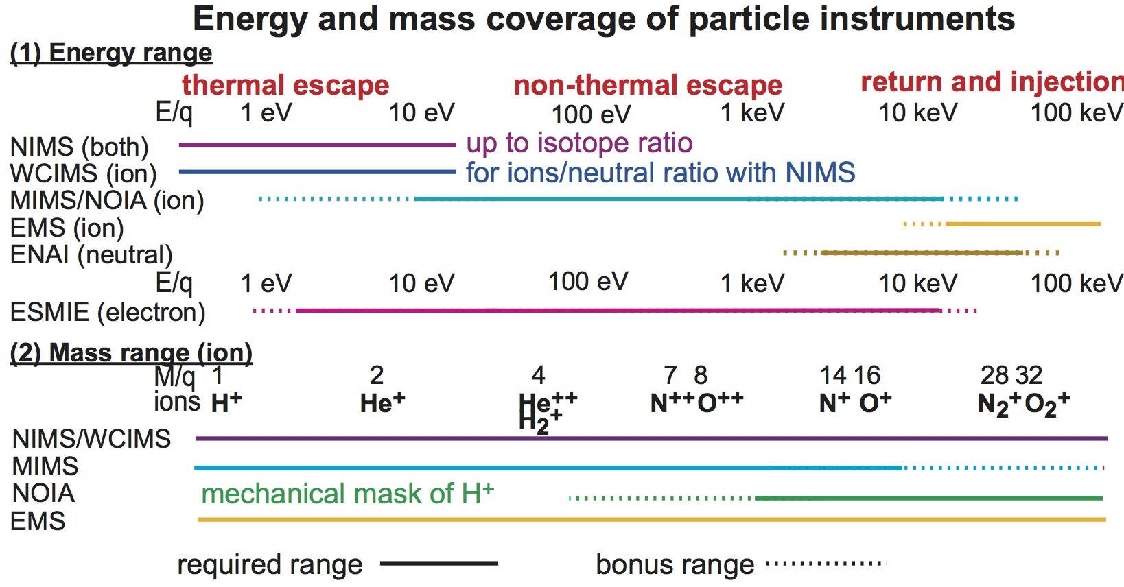
Energy and mass coverage of the particle instruments
INMS (both)
(both)
INMS/WCIMS

Slide 18
UVIS coverage
Too bright
Too bright
O⁺
N
O
O
N⁺
N
N₂
and at 58 nm (He) & 30 nm (He⁺).
18

Slide 19
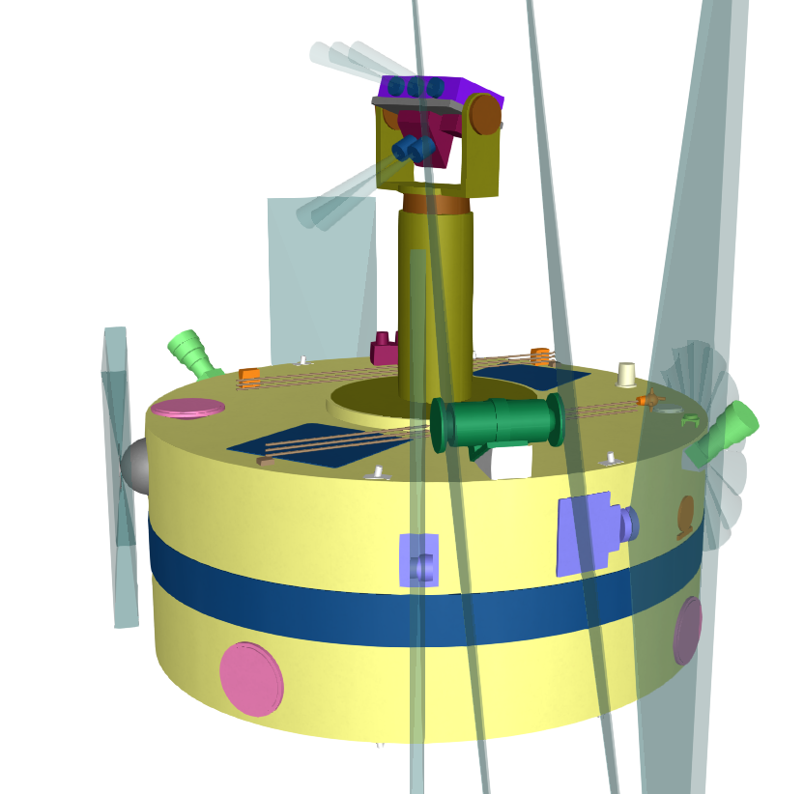
ESCAPE spacecraft
UVIS
AMC
UVIS & AMC DPU
MIMS
WCIMS
EMS
ESMIE
Main spacecraft: 2.40 m diameter x 1 m height
Despun platform mast: 0.35 m diameter x 1.5 m height
Thanks to PASO-CNES

Slide 20
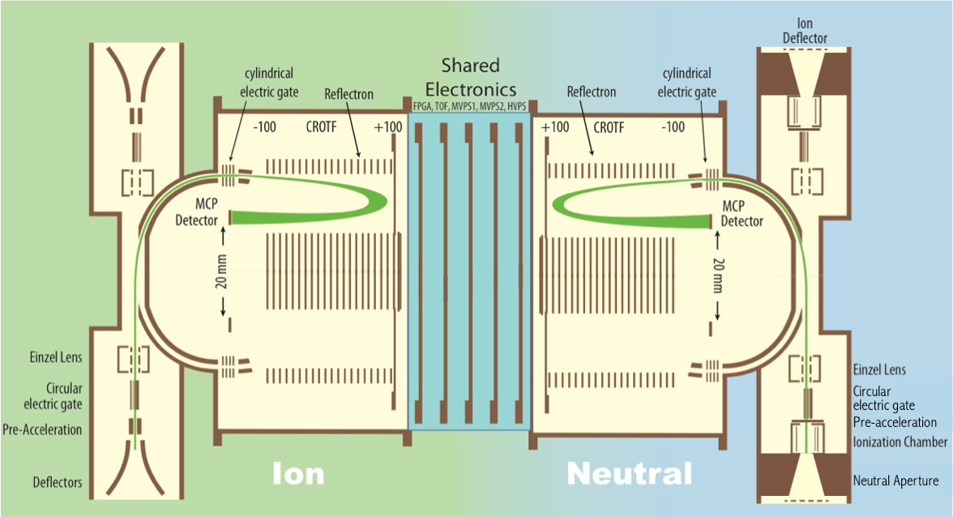
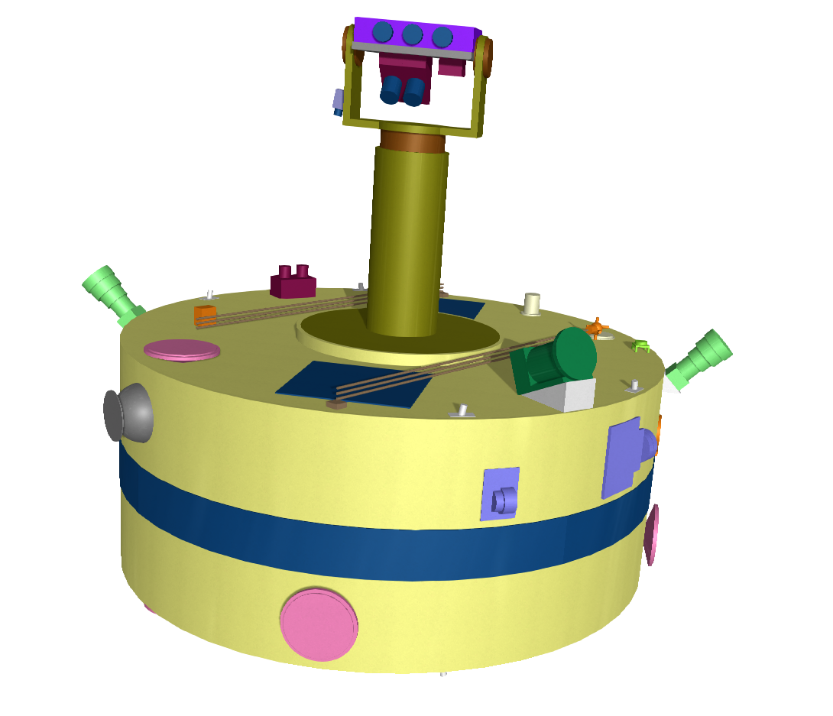
Ion Head FOV
180°x 1°aperture looking outward radially
Neutral Head FOV
180°x 1°aperture looking outward radially
WCIMS: updated design
WCIMS detectors head (new design) 40 cm x 20 cm approximate cylinder
Ions: E ~0-40 eV and full velocity scan with spin, mass range up to 40 amu, mass resolution M/ΔM ~60.
Neutrals: No energy distribution but densities & temperatures with spin resolution, mass range up to 40 amu, mass resolution M/ΔM ~60. The neutrals aperture will be active within ~30°(+/-15°around ram).
WCIMS
MIMS
EMS
WCIMS and INMS are complementary:
INMS provides a higher mass resolution (M/ΔM >1000), but does not provide distribution functions (ions) and temperatures (neutrals), essential for escape modelling.

Slide 21
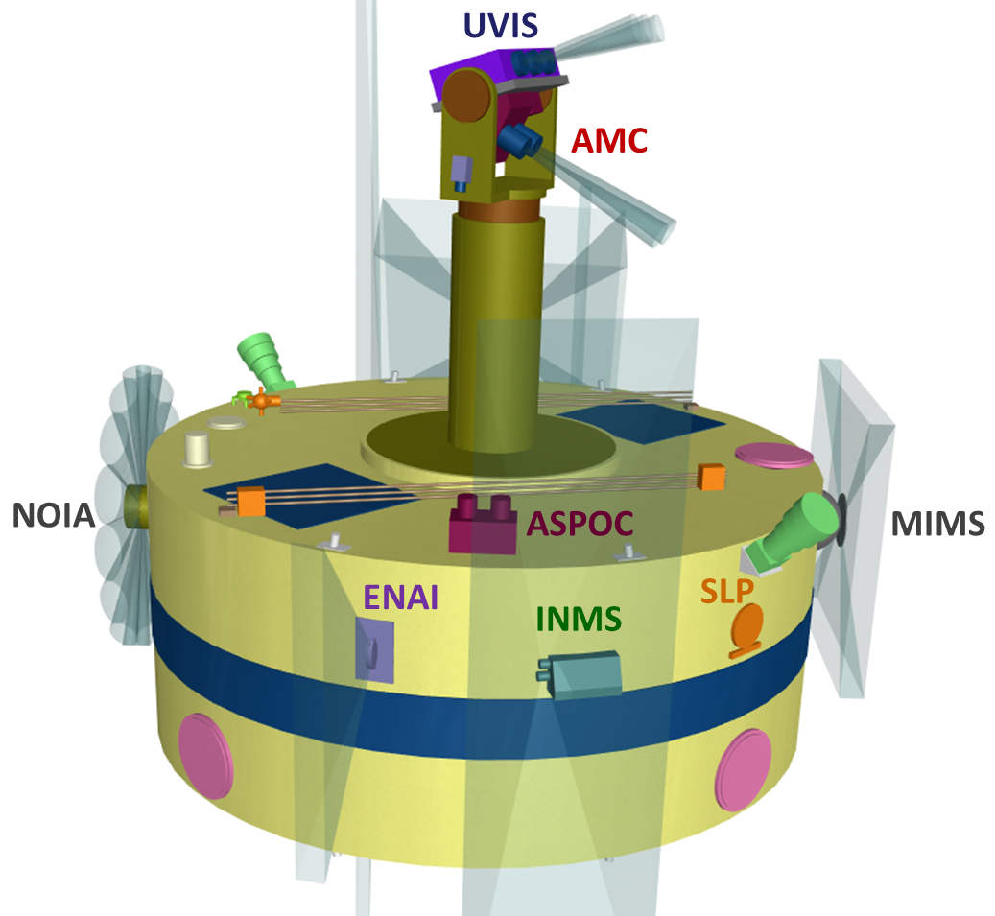
service camera
MAG
Search Coil
Thanks to PASO-CNES

Slide 22
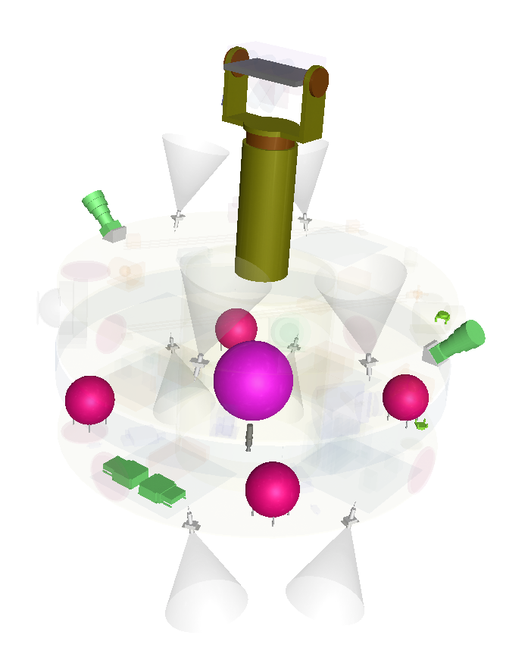
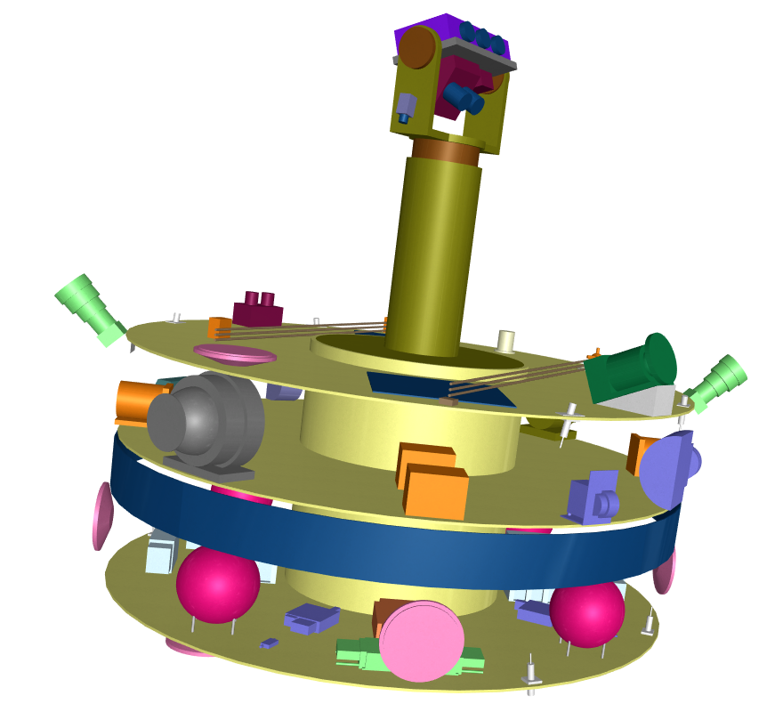
stellar sensor
AMC
UVIS
service camera
UVIS & AMC DPU
Xe tank*
Hydrazine tank (EOL deorbiting)
Xe thruster
SLP e-box
Waves e-box
ESCAPE attitude and orbit control system
Particles DPU (behind)
* Could be Kr, Xe, or a mixture of noble gases
ESCAPE satellite internal view

Slide 23
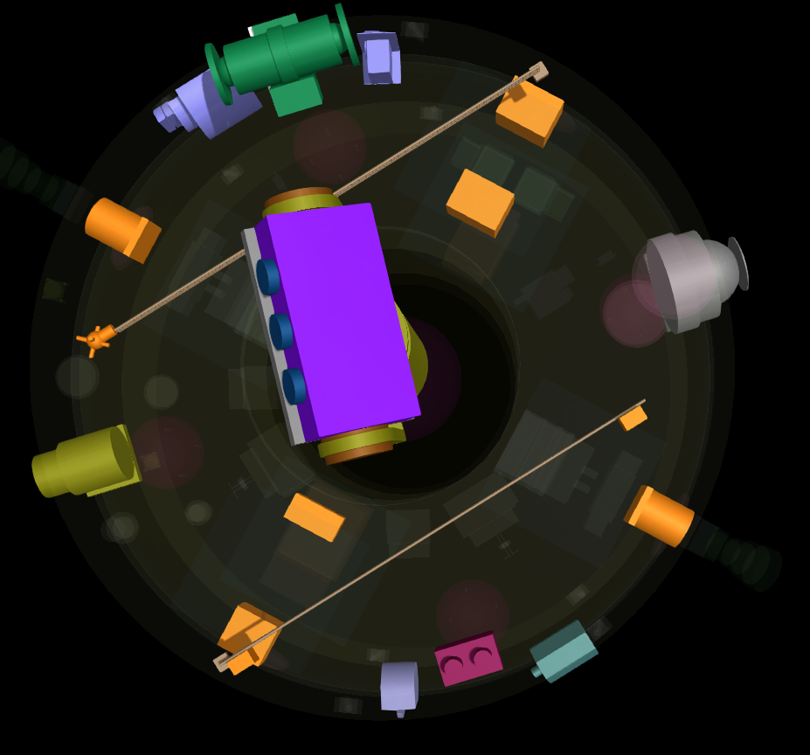
ESCAPE possible instrument accommodation
WCIMS
ESMIE
EMS
Waves e-box
SLP housing
SLP e-box
MIMS
UVIS
Search Coil
MAG
NOIA
SLP housing
Particles DPU
MAG e-box
ASPOC
INMS
ENAI

Slide 24
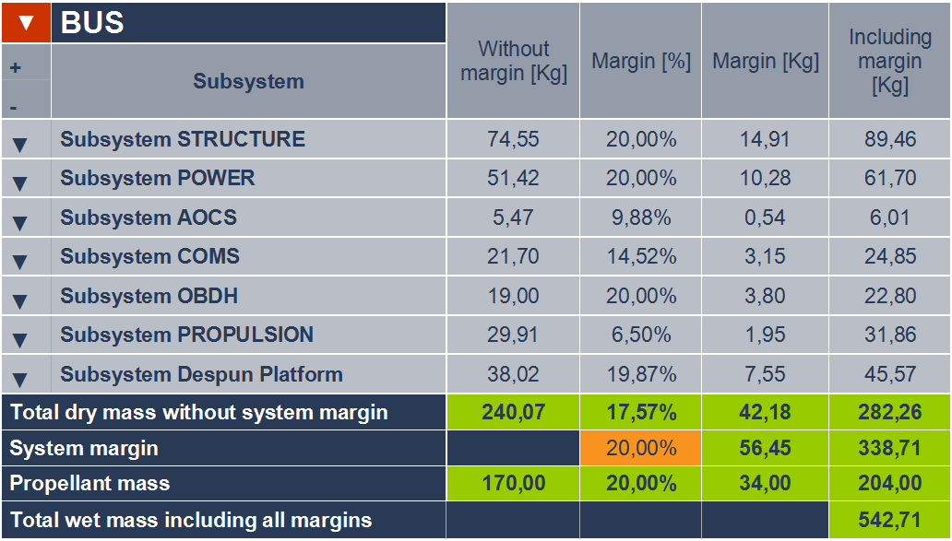
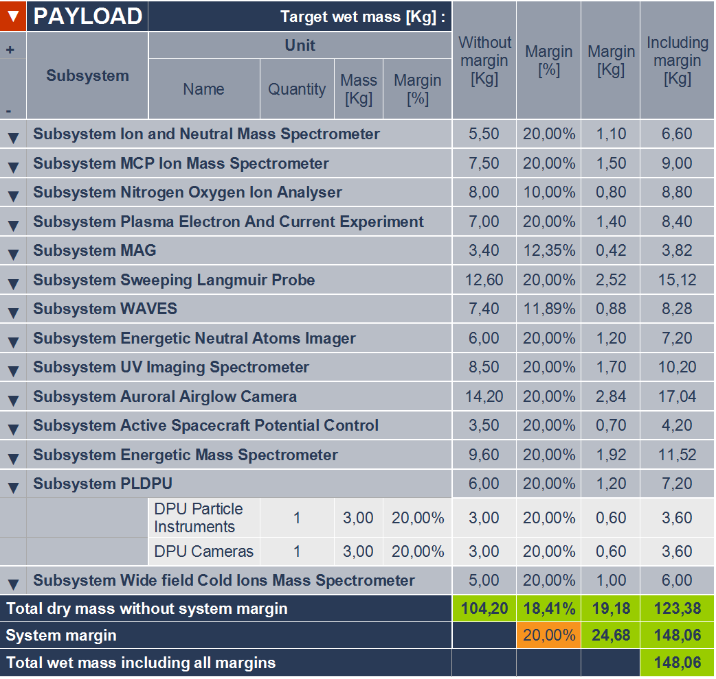
ESCAPE spacecraft bus and payload mass budget
Total system mass (bus + payload + propellants), including margins: ~700 kg
Total system power, including margins: ~450 W
ESCAPE total mission cost for ESA: ~340 M€ (<< the 550 M€ ESA M5 ceiling)

Slide 25
ESCAPE : Schedule
ESA driven
Phase A: 2018-2019
Phases B - D: 2020-2028
Launch: ~2029
Operations: ~2029-2032
Extended mission: TBD
ESCAPE : Model Philosophy (at least for MIMS)
1 STM (Structural & Thermal Model)
1 EM (Engineering Model)
1 QM -> SM (Qualification Model -> Spare Model)
1 FM (Flight Model)

