Slide 1
update 2022-0207b
Element | mass
Balloon (2 balloons 4m/5 m diameter) | 690 (+180) kg = 90 kg x 2 + entry/tank etc 510kg x 1 550? (+140) kg = 45 kg x 2 + entry/tank etc 460kg? x 1 (using single thermal shield for several balloons)
3.54 m diameter Vega balloon teflon , seperated from launder | total 21 kg = balloon (He 2 kg) + gondola 7 kg
extra balloons without payload | 30 kg without gondola / each
cf. EVE (6 m diameter) = 160 kg | balloon (27 kg + He 16 kg) + gondola 116 kg entry/tank etc 506 kg/CNES => total 665 kg
90 kg => 5 m diameter ? | balloon (21 kg + He 10 kg) + gondola 58 kg
45 kg => 4 m diameter ? | balloon (15 kg + He 6 kg) + gondola 23 kg
dry mass | 1200 (+25%) kg
balloon + entry shell | 550 (+25%) kg, all balloons must be equal
pure orbiter | 600 buss + payload (+25%) kg => 50 kg payload (UHF relay 10W/5kg, + SI 40-45 kg
cf VEX/EnVision | 700/805 kg dry mass, with 93 kg/212 kg payload
orbiter (balloon related) | 5 (+25%) kg = transmitter
orbiter (other payload) | 40 (+25%) kg = camera (25-30 kg) + in-situ (10-15 kg)
cf. Akatsuki | 35 kg / 5 cameras with 320 kg dry mass
Fuel (Xe) | 600 kg
balloon power | max 40 W / battery + solar panel (IR wavelength)
cf ESA annex (for Venus) | < 1200 kg (+350 kg) dry mass + 600 kg fuel

Slide 2
update 2022-0207
Update 2022-02-07 Balloon team
(1) Maximum payload that a ballon can have is not yet clear (even if we use common thermal shield for multiple balloons)
(2) We made priory list: 1 = mimimun payload (location+T+P), 2 = for higher acculary, and 4 = good to have for both redundancy and deep understanding.
(3) Vega type observation with “multiple balloon + monitoring from obiter” provides minimum science (priory 1) and the sells point
(4) It woud be nice that we have “additionl science beyond Vega”
(5) However, mission target is always “dynamics and energy” but not chemistory or small scale

Slide 3
update 2022-0207
1.1. Unsolved issue 1: 3D-dynamics (fit into only 2 balloons at 60°)
"What is the 3D dynamics in critical region at 40-60 km (main dynamics zone)?"
1.1.1. Dynamic related to super rotation
"What are actual roles of (meridional) circulation and (gravity) waves in mainteining the super rotation?"
1.1.2. Dynamics hidden by super rotation
"How are the dynamics (shear, eddy, wave) other than super rotation: their relation to the super rotation, and any similarly to or essential difference from the Earth?"
1.1.3. Thermodynamics
"Is air parcel stable and unstable? What is the exact latent heat?"
1.1.4. Validity of Venus GCM (combine with 1.1.1 or 1.1.2 or 1.1.3)?
"Does Venus GCM represent actual Venus atmospheric dynamics?
1.2. Relation to plasma dynamics
"What is the relation between the neutral dynamic and ion dynamics (wording later)? "
1.2.1. Wind in the thermosphere
"How much of the neutral circulation are influenced by charged particles? (global scale)"
1.2.2. Is ion primary or neutral primary?
"How does the ion-neutral coupling work in the thermosphere/ionosphere? (process)"
(option: do we add science for radio occultation, or ignore) => Is peak altitude of Ne related to wind relation between balloon and orbiter?) VEX made 135 km dive (Envision, 220x400km)

Slide 4
Balloon payload
update 2022-0207
requirement for location determination: from orbiter, < 50 m (ideally < 10 m)
inter-balloon, < 10 m (when distance is < 100 km)
balloon payload |  | mass | power/telemetry | 1.1.1 | 1.1.2 | 1.1.3 | 1.1.4 | 1.2
UHF directional antenna system (Balloon location), HF beacon for only direction? | 1 | 1 kg (only UHF) | 5 W transmit UHF power | x | x | x | x
extra VHF antenna system (not good from technology) | (2) | CFE, Raphael | cf. cubesat |  |  |  |  | x
inter-balloon communication system (???) | 2 |  |  | x | x | x | x
Balloon T + P (up to 10 Hz) | 1 | < 1 kg | < | (x) | (x) | x | (x)
cf. Huygens 6 kg
wind (mHz correction) | 2 | < 0.5 | < | x | x | x | x
(IMU ????) | 4 | < 2 kg | 12-18 W | x | x | x | x
cloud camera (simple one) or lightning monitor (optional) | 4 | 0.3 kg | heavy bps easy | (x) | (x) | (x) |  | x
humidity of some molecule (capacitor) => task phase 0 | 2 | 0.1 kg |  |  |  | x
heat flux measurement | 2 | raphael |  |  |  | x
(aerozol instead of humidity?) |  | ? kg | ? |  |  | (?)
extra balloon(s) = Vega | 4 |  |  | x | x | (x) | x

Slide 5
60 km ~ 0.2 bar (0.5 kg/m³)
⇒ buoyancy = 0.4 kg/m³(He)
& (-35°) ~ -10°C
diameter
6 m | 900 m3
5 m | 520 m3
4 m | 265 m3
3 m | 110 m3
55 km ~ 0.5 bar (0.9 kg/m³)
⇒ buoyancy = 0.8 kg/m³(He)
& (-15°) ~ +30°C
50 km ~ 1.0 bar (1.6 kg/m³)
⇒ buoyancy = 1.4kg/m³ (He)
& (+50°) ~ +70°C
45 km ~ 2 bar (2.6 kg/m³)
⇒ buoyancy = 2.3 kg/m³(He)
& (+90°) ~+115°C
40 km ~ 3.5 bar (4.4 kg/m³)
⇒ buoyancy = 4.0 kg/m³(He)
& +145°C

Slide 6
update 2022-0204
Update 2022-02-04 In-situ payload team
(1) Total mass should be < 45 kg, i.e., less than half of VEX (93 kg). Otherwise, ESA considers the mission is too complicated. cf. Akatuki payload was total 35 kg with 5 cameras.
(2) We have a IR camera (one instrument from ESA’s view), which has "two aperture (eventualy 2 cameras)”, NIR and LIR
- From ESA side, just adding one camera (even as sub-unit with 300 g) cost a lot for spacecraft, and phase-1 proposal should limit only 2 sub-camera
- to call one camera for NIR , flters for NIR1 and NIR2 are time shearing (if I understand right, please correct me).
- Important wavelength is NIR1 and NIR2, but need to check there efficiency (Akatsuki could not get sufficient information, if I understand right)
- We did not discuss LIR because it covers > 60 km. (still need to discuss if we can do “required science” without it.
- As the 4th camera (Visual Monitoring Camera) would be useful
(3) The same strategy for "direct wind measurements” with ion sub-unit and neutral sub-unit
- Ion sub-unit is well established technology and < 4 kg
- Neutral wind measurements is either by accelerometer or by wind meter. We need to know the specification and heritage for wind meter (sensitivity at > 200 km altitude, compared to accelerometer, under 7 km/s velocity)

Slide 7
Orbiter payload
update 2022-0204
orbiter payload | mass | power | 1.1.1 | 1.1.2 | 1.1.3 | 1.1.4 | 1.2.1 | 1.2.2 | target
Balloon location (equipment at orbiter) |  |  | x | x | x | x
Imaging (NIR1) |  |  | x | x | (x) | x |  |  | 40-50 km
Imaging (NIR2) |  |  | x | x | (x) | x |  |  | 45-55 km
Imaging (LIR) |  |  | (x) | (x) |  | (x) |  |  | 60-80 km
Visual Monitoring | 0.3 kg |  | (x) | (x)
total inertia of wind / wind | 5-10 kg |  |  |  |  |  | x | x
Ion velocity | < 5 kg |  |  |  |  |  | x | x
One camera (with 2 channel) + optional camera < 20 kg?
One "wind" (with ion channel and neutral cannel) < 10 kg?

Slide 8
update 2022-0203
Update 2022-02-03 science team
Define scientific question (2 critical regions on Venus atmospheric dynamics)
Merge §1.1.3 to §1.1.1 or §1.1.2 or §1.1.4
Re-define sub-themes of §1.1 into equal type
2. orbiter requirement
Low-altitude orbit during balloon (Envision, 220kmx400km)
⇒ Camera monitors near balloon but not global
Deep dive to as low altitude as possible for ion/neutral wind (VEX dived 135 km)
If possible, increase apocenter later (requires a lot of propulsion, and should simply be "option")
3. trace matrix
First version is made
"optional" measurement requires new "sub themes"
⇒ radio occultation and mm waves
We must include mass and power
⇒ cf. VEX 1240 kg (wet), 93 kg (payload)
Akatsuki 518 kg (wet), 35 kg/5 cameras

Slide 9
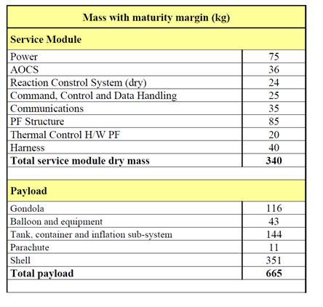
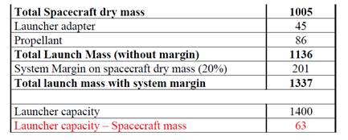
EVE proposal (M3, 2010)
1 balloon + 1 prove
instead of entry shell =>
Entry module (just entry without no science and release balloons+parashutes at 50-60 km altitude. Afterward just crash to the surface)
=> this scenario requires to release entry module before arrival => long distance to Venus

Slide 10
Venus Balloon for M7 (or M8)
Venus (at < 60 km altitude) is largely hidden by thick cloud
⇒ Many important science questions remains
Surface science (volcano & tectonics, both present and past)
Atmospheric/Cloud science (dynamics, chemistry)
But "majority of remote-sensing science" are largely taken by
Venus Express (Atmosphere + Magnetosphere, arrivde 2006) , RS
Akatsuki (Super-rotation, arrived 2015) , RS
Shukrayaan-1 (Atmosphere + Ionosphere, 2024) , in-situ (+ balloon)
VERITAS (Surface, 2028) , RS selected June 2021
EnVision (Surface, 2031) , RS selected June 2021
DAVINCI (Atmosphere, 2029) , lander + RS selected June 2021
? NASA's Venus cloud explorer (Atmosphere) , balloon+RS
? Venera-D (Atmosphere) , balloon+lander+RS
⇒ Only Indian balloon is "approved" at present

Slide 11
Venus Balloon for M7 (or M8)
Cloud/atmospheric science using balloons (chemistry, dynamics)
Any "attractive" science theme beyond past/approved missions?
Must differentiate from NASA’s big (Venus Cloud Explorer) mission?
Akatsuki ⇒ Super rotation is mainly maintained by thermal-tide of the cloud
VEX ⇒ many thing chemistry and heat including D/H ratio and surface hot spot
Indian ⇒ some local dynamics and chemistry at convection layer
DAVINCI ⇒ full composition all the way down
(Cloud Explorer) ⇒ everything that can be done with single balloon
A to (1): Convection and waves are "contaminated" by super rotation
⇒ Need to understand other dynamics and their relation to super-rotation
(Are they common with the Earth, or unique to Venus/super-rotation?)
A to (2): Multipoint measurement is possible "method" that would be new
⇒ Only very small payload is possible, i.e., radiosonde type
(Instruments of orbiter must reinforce it)
⇒ 3D convection at 3D atmosphere: minor convection and its relation to the super rotation up to thermosphere

Slide 12
Venus Balloon for M7 (or M8)
3D convection at 3D atmosphere:
Minor convection and its relation to the super rotation
(unique to Venus or common with the Earth?)
From below the cloud up to thermosphere
(relation with ion's super rotation in the ionosphere?)
Payload (dry mass: 1500 kg, payload=20%=300 kg)
Multiple balloons: “equal-many sisters” rather than “mother-daughter?”
minimum 4: low latitude < 40° + polar 70°, two different altitude
cf Vega: 3.4 m radius, 12kg balloon + 6kg gondola, 6 kg payload
Can we put extra instrument, like infrasound (from mass/power viewpoint)?
Is camera possible to put on orbiter (from DSN telemetry/budget viewpoint)?
Ionospheric convection: how many instruments are needed?
How to maximize communication to balloon both equatorial (T=4 days) and polar region (T=20 day) using polar orbiting SC (best option to drop balloons)?
Polar orbiting SC means communication is only 20 min x several orbit for every 2nd (equator balloon) / 10th (polar balloon) days.
To save power, balloon send data when balloon receives orbiter's radio signal

Slide 13
Venus Balloon for M7 (or M8)
Officially lead (Management structure: 2 page)
Gebriella + Moa
Science question (3 page): Yama + Javi
Mission configuration (3 page including payload)
SC + communication + balloon derivery: Martin+Rene
Payload (Balloon, Optics, In-situ)
* Balloon: ??? ask Raphael
* Optics: Marc + Javi + Christian
* In-situ: Manabu?

Slide 14
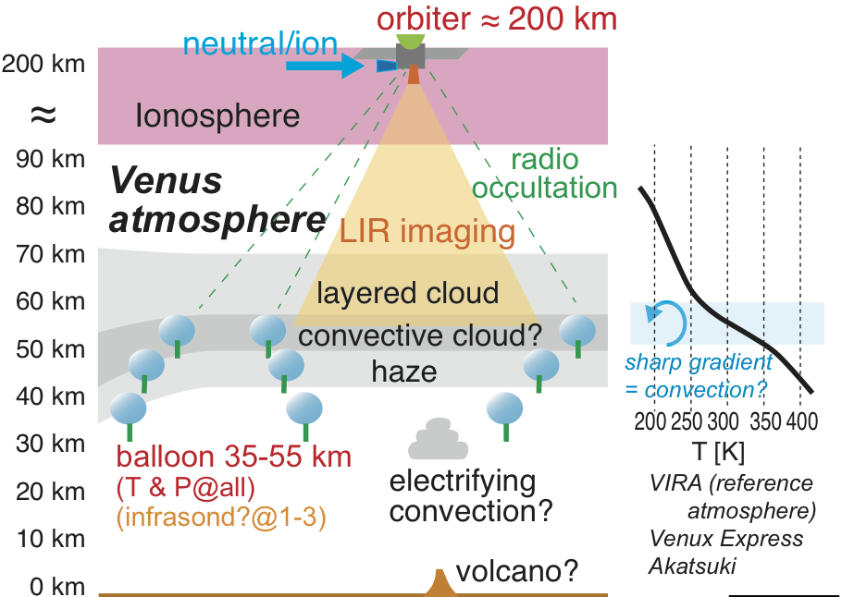
Venus Dynamic Tracer (VdT)

Slide 15
Venus Dynamic Tracer (VdT)
Tracing "air motion" from "atmospheric ocean" to the thermosphere to understand 3D dynamics of the Venus atmosphere
Aim
The Venus Dynamic Tracer (VdT) mission aims to understand the driving mechanism of the Venus atmospheric dynamics: how its momentum and energy including heat are transferred three dimensionally in a planetary scale. Although the super-rotation is now explained by thermal-tide in the cloud layer, its coupling with actual vertical and meridian convection is not clear. Also the relation with the ionospheric super-rotation is another unknown question.
This requires measurement of the motion of local air parcel (wind) and temperature:
from equator to the pole
from below the cloud ("atmospheric ocean" where the atmosphere is stable) up to thermosphere (ions start to play role in the atmospheric motion)

Slide 16
Venus Dynamic Tracer (VdT)
Payloads
Many small balloons (2-3 latitudes x 2-3 height at 30-60 km) to trace the air motion
Radiosonde-type measurement (only P, T, and possibly wind, no commanding)
Balloon telemetry is used for Occultation and Doppler shift measurements.
Extra measurement (infrasound, IMU, etc) at lowest altitude (=largest buoyancy)
Use N₂ gas, because it does not easily leak through the skin (He leaks quickly)
⇒ Target 120 days, but science requirement is > 20 days
(buoyancy difference from He = 10 km difference in altitude (80° higher T)
Ion and neutral wind in the thermosphere as low as possible (≤200 km)
⇒ candidate: acceleromer, ion drift meter, ion/neutral velocity detector
imager (LIR?, Akatsuki-type) to trace the cloud layer, if possible
Option,
Both He balloons (quick descend from high altitude) and N₂ balloons (slow descend from low-altitude) are mixed.
Extended mission
Increase orbiter altitude after balloon telemetry is dead:

Slide 17
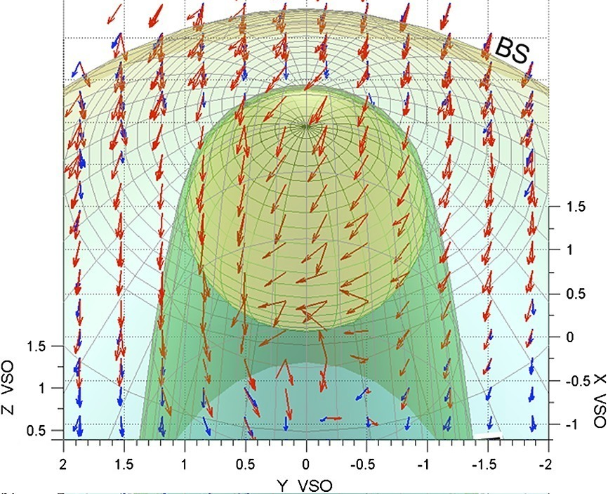
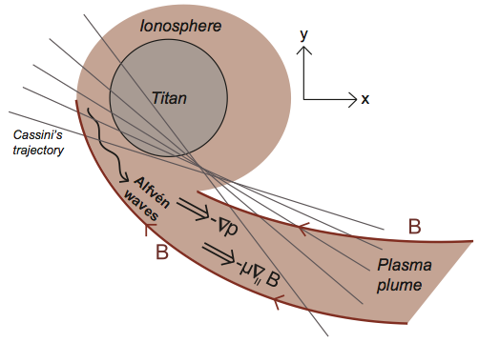
Venus Dynamic Tracer (VdT)
Motivation
Ionosphere also shows super-rotation of ions. Is it driven by neutral super-rotation or by ionospheric thermal tide or by solar wind? In latter cases, how much is the atmospheric super-rotation affected by ion motion? Tracing these motions give hint to understand the "super-rotation" and the "ion-neutral interaction"
(Lundin et al., 2013)
(Edberg et al., 2011)
(a) VEX observation suggests ions flows 10 times faster than neutral super-rotation.
(b) Massive escape of cold ions & atmospheric super-rotation for Titan

Slide 18
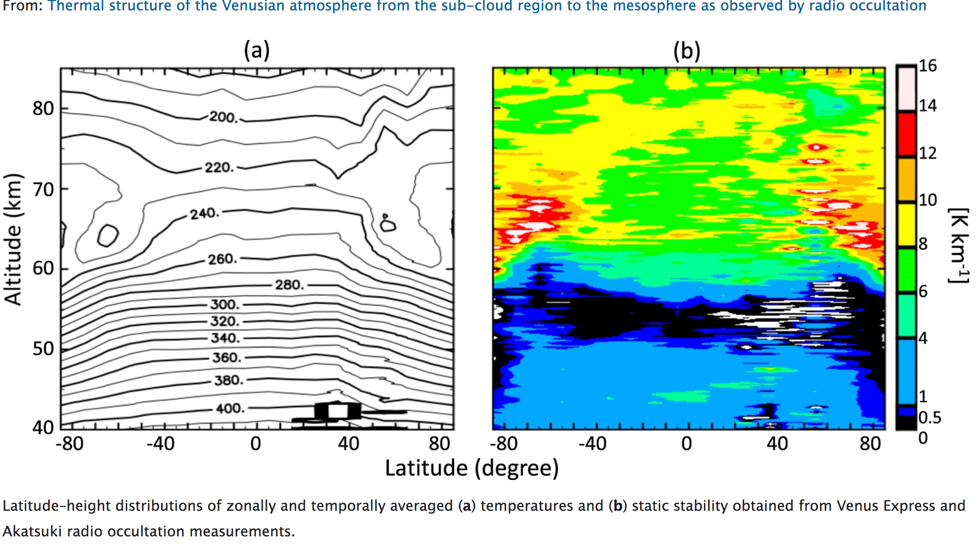
Venus Dynamic Tracer (VdT)
Relation between super rotation and other convection
The super-rotation makes the Venus atmospheric dynamics quite different from that of the Earth, causing many large-scale and meso-scale convections hidden by the super-rotation and relevant waves. How the atmospheric motion is effected under the influence of super-rotation is still unknown with many theoretical predictions. Prediction by Venus GCM model must be examined.
(Ando et al., 2020)

Slide 19
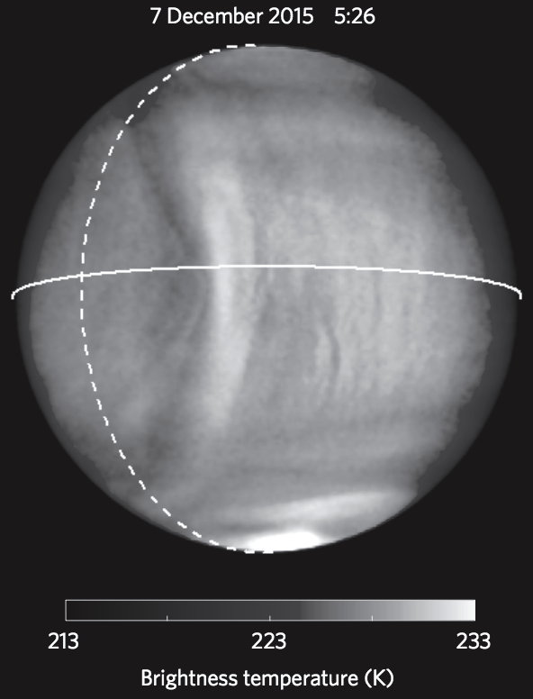
Venus Dynamic Tracer (VdT)
Convection is more complicated than simple 1D zonal. One example is "mountain wave" that stays at the same longitude (local time for Venus).
To understand it, we need to measure local dynamics below the cloud.
Akatsuki LIR observation of brighness at 60-70 km

Slide 20
Venus Laputa: Why N₂ balloon?
Helium gas leaks through skin
⇒ Use N₂ (M=28) instead of He (M=4)
Still buoyant in CO₂ atmosphere (average M~40)
Large diameter of N₂ ⇒ easier to remain
molecule | kinetic diameter | mass | leak* (CO₂=1)
He | 2.60 Å | 4 | > 100
NH₃ | 2.60 Å | 17
H₂ | 2.89 Å | 2 | > 100
CO₂ | 3.30 Å | 44 | 1
O₂ | 3.46 Å | 32 | ~ 1
N₂ | 3.64 Å | 28 | < 0.03
CO | 3.76 Å | 28
CH₄ | 3.80 Å | 16
Easy to leak
Somewhat leaks
Remains
* Permeability through EVOH (Ethylene–Vinyl Alcohol Copolymer) compared to CO₂

Slide 21
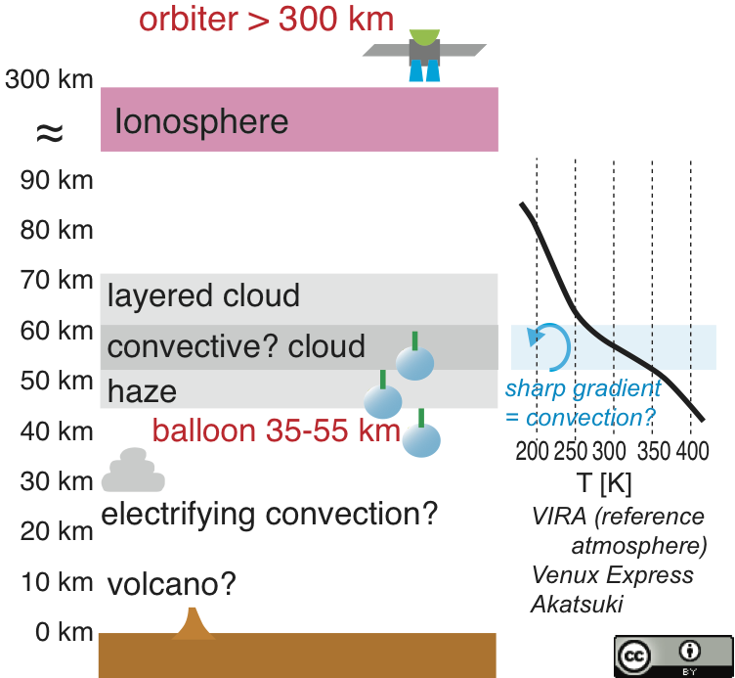
N2 give enough buoyancy @ <55 km
~ troposphere@Earth
pressure / density / buoyancy
60 km ~ 0.2 bar (0.5 kg/m³)
⇒ 0.15 kg/m³(N₂) & 0.4 kg/m³(He)
& (-35°) ~ -10°C
55 km ~ 0.5 bar (0.9 kg/m³)
⇒ 0.3 kg/m³(N₂) & 0.8 kg/m³(He)
& (-15°) ~ +30°C
50 km ~ 1.0 bar (1.6 kg/m³)
⇒ 0.5 kg/m³(N₂) & 1.4kg/m³ (He)
& (+50°) ~ +70°C
45 km ~ 2 bar (2.6 kg/m³)
⇒ 0.9 kg/m³(N₂) & 2.3 kg/m³(He)
& (+90°) ~+115°C
40 km ~ 3.5 bar (4.4 kg/m³)
⇒ 1.5 kg/m³(N₂) & 4.0 kg/m³(He)
& +145°C
Notes:
To have a long flight, the optimum altitude is 35 to 55 km high
because pressure at these altitudes is high enough within acceptable temperature range

Slide 22
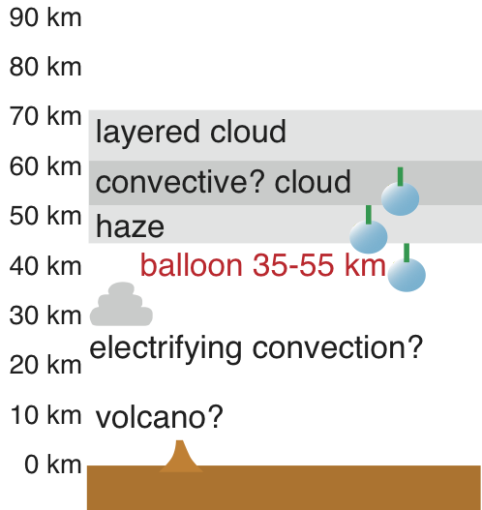
Simple N₂-balloon test for its survival
e.g., dropping small N₂ balloons with simple transmitter (and simple measurements like T and P) that can survive long with tough environment (piggy-back to atmospheric modules to the other missions, e.g., Venera-D if opportunity exists)
⇒ just positioning gives good science
The buoyancy force is higher at lower height (high pressure), and may survive long there

Slide 23
Venus Dynamic Tracer (VdT)
This is the first proposal of atmosphere-ionosphere dynamic coupling.
- science
- design (instrumentation)
- "lead" of the proposal
- "lead" of each instrument package (balloon, camera, in-situ)
Temporal Contact: M.Yamauchi@irf.se

Slide 24
Venus Dynamic Tracer (VdT)
Mission payload summary
Multiple small balloons at 2-3 different altitudes (35-60 km) and at 2-3 different latitudes including the polar region are deployed.
Balloon payload is only radiosonde-type (P, T, wind speed, radio equipment for telemetry and positioning relative to the orbiter. Minimum or no "commanding").
Altitudes of the balloons are adjusted by adding extra payload mass, e.g., infrasound & IMU (Inertial Measurement Unit) , for lowest altitude ones.
To make the balloons to survive long (target 120 days), we use N₂ gas if possible, because the N₂ gas does not easily leak through the skin unlike the He gas.
The radio-transmission from these balloons to the orbiter is also used for radio occultation and Doppler shift measurements, to obtain the integrated effect of temperature and vertical velocity over the altitude.
Orbiter measures neutral wind and ion drift velocity at as low altitude as possible (≤200 km).
Orbiter also has camera to monitor cloud motion and confirming balloon motions.
The low-altitude orbit ends after the nominal operation (4 month period when some balloons are floating), and change its altitudes to survive longer period as "extended mission period".
As an option, both He balloons (quick descend from high altitude) and N₂ balloons (slow descend fro low-altitude) are mixed to change of altitude range.

