Slide 1
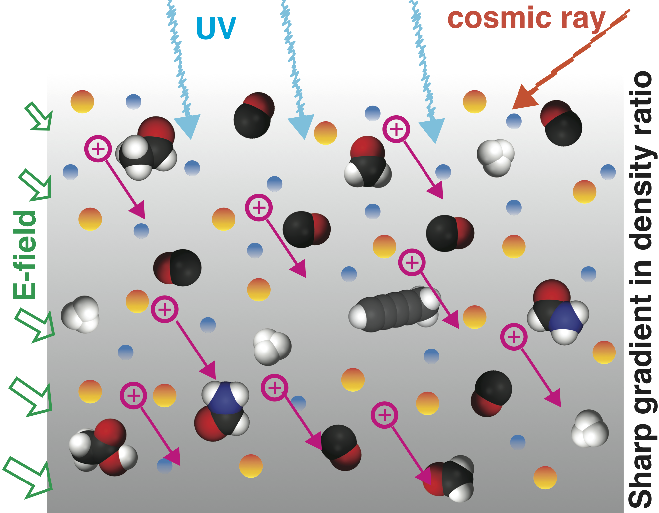
Plasma-neutral gas interactions in various space environments beyond simplified approximations:
M. Yamauchi (IRF), J. De Keyser (BIRA-IASB),
and the Voyage 2050 White Paper team

Slide 2
Why ion-neutral interaction?
Observations of partially ionized plasma in space suggest that the present knowledge on plasma-neutral gas interactions is far from complete, particularly for low energy.
⇒ ion-neutral cross-section in space cannot be quantitatively measured in laboratory !
Low-energy particles are easily affected by the environment, particulary by (a) tenuous gas with gradient (b) very low temperature (c) micro-gravity.
Many sources of external energies into the system that are high compared the neutral/ion energy (e.g., E, UV, radiation, electron, cosmic ray) and convoluted.

Slide 3
Why ion-neutral interaction?
⇒ ion-neutral cross-section in space cannot be quantitatively measured in laboratory !
We then have the following questions:
Physical aspect (Theme A): What is the actual neutral behaviors in a tenuous plasma (upper thermosphere and exosphere, comet, interstellar medium), particular for low-energy? ⇒ this talk
Chemical aspect (Theme B): How organic matters are formed in low-density and low-temperature environments (titan ionosphere, comet, interstellar medium), where neutral-neutral interactions is less efficient than neutral-ion interactions ?
⇒ not today

Slide 4
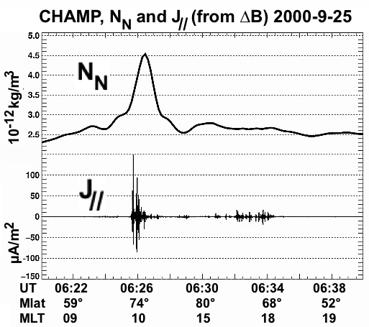
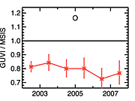
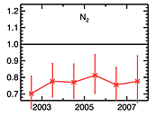
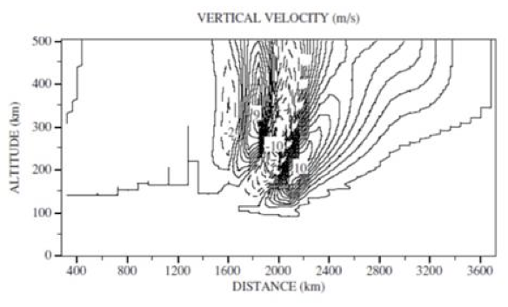
ex.1 Earth: neutrals behavior in thermosphere/exosphere
at 194 km altitude
above 400 km altitude
(Lühr et al., 2004).
TIMED/GUVI
(Meier et al., 2015)
ratioes at 143-387 km
(Shinagawa and Oyama, 2006)
No matter how the data is tuned, discrepany of 20% remains
Density bump (upward wind) has been qualitatively explained by Joule heating, but simulation does not re-produce it
⇒ (a) Observations depart from of the models, particularly during large during magnetic storms (when ion escape is strong), suggesting higher ion-neutral than model

Slide 5
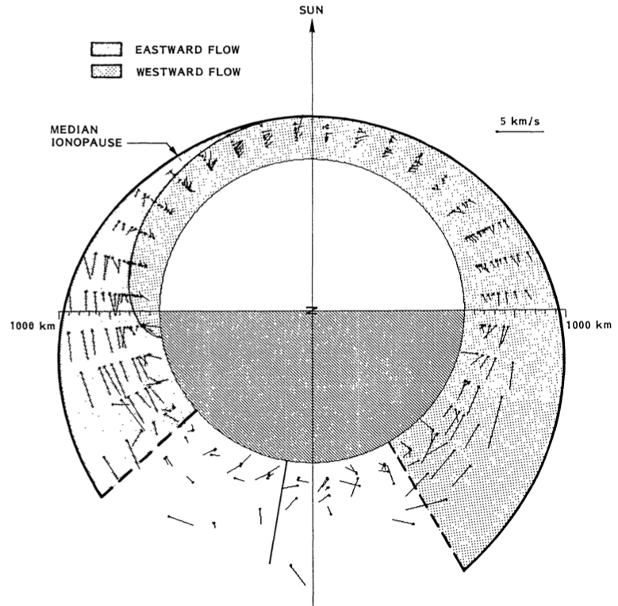
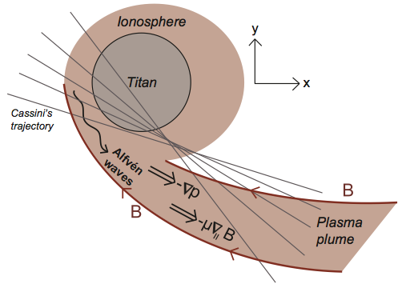
ex.2 cold ion motions (Venus/Titan)
(Miller and Whitten, 1991)
(Edberg et al., 2011)
Pioneer Venus Orbiter found dawn-dusk asymmetry of cold ion convection in the super-rotation direction
Cassini found unexpectedly high density cold ions at the upper Titan ionosphere and subsequent high escape rate.
Super-rotation in "stand-still" planet
Fast cold ions flows in "stand-still" satellite
⇒ (b) Momentum transfer is still mystery, suggesting higher ion-neutral momentum than model

Slide 6
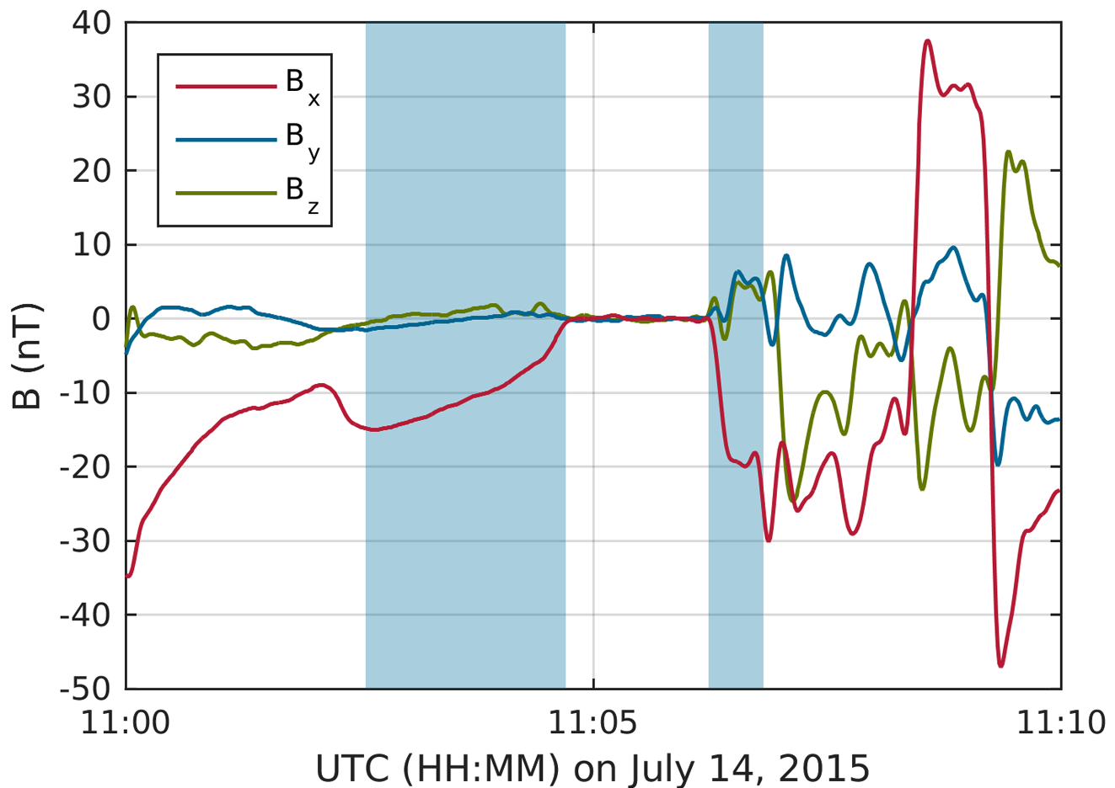
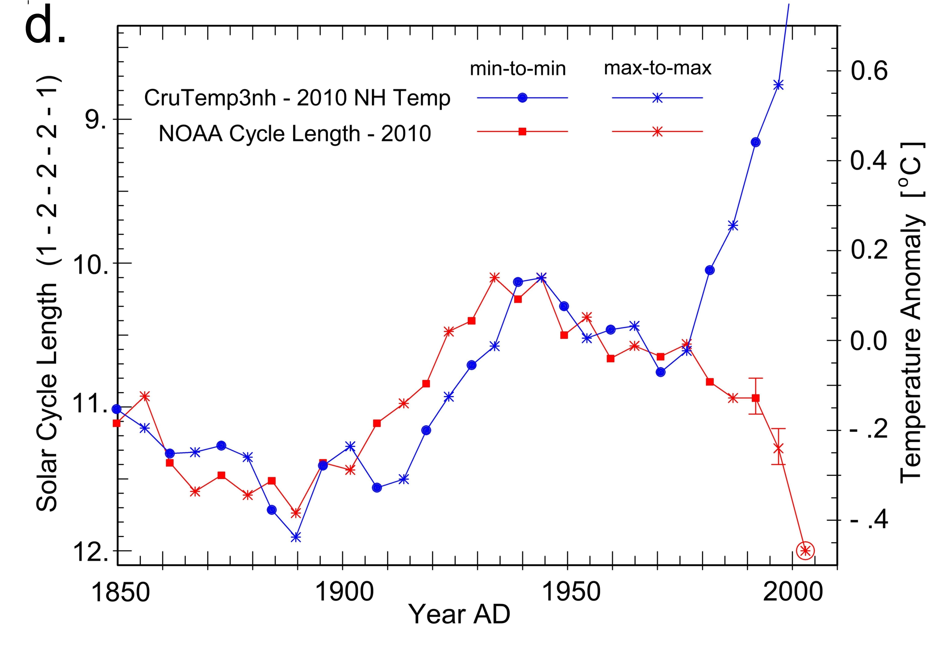
ex.3 Comet magnetic cavity
ex.4 climate change
Blue: Length of sunspot cycle.
Red: Northern hemisphere average temperature
(Stauning, 2011)
(Goetz et al., 2016)
Before human effect take over ~ 1980, solar cycle length and temperature are correlated
Rosetta observations of magnetic cavity is still mysterious.
⇒ (d) but the mechanism that connect plasma and neutral atmosphere is not known, and we need to know the ion-neutral interaction in the upper atmosphere
⇒ (c) Although it is comet "exosphere," influence of neutrals can be substantial, suggesting higher ion-neutral momentum than our knowledge

Slide 7
Theme (A): physical aspect
How and by how much do plasma-neutral gas interactions influence the re-distribution of externally provided energy to the composing species?
(A1) Impact of ion-neutral energy exchange on long-term evolution of planet, comet, ring, etc.
(A2) Structures and variability of the upper thermosphere and exosphere
(A3) Energy cascade in partially ionized plasma with large gradients or layered structures
(A4) Role of ion-neutral momentum transfer in the super-rotation and cold ion flows

Slide 8
What to measure?
Basic parameters that must be measured (mandatory):
ion energy/velocity distribution (including density)
neutral energy/velocity distribution (including density)
(3) composition if posasible
Possible parameters that influence the interaction (optional measurements) :
Temperature
Density and ionization ratio (including their gradient)
Gravity
External free energy (electron, cosmic ray, E-field, B-field, EM wave)
note. these extreme conditions are difficult to achieve by laboratory experiments

Slide 9
Where to go?
Here, we assume M-class / F-class payload.
M-class dedicated mission (Earth/Venus)
F-class payload onL-missions (> 2 AU)
Mission destination | (1) T | (2) n | (3) g | A1 | A2 | A3 | A4 | mother mission^{*2}
Interstellar/Oort cloud | very low | very low | very low | x | - | x | (x) | LL or L
Ice Giant atmosphere | very low | medium | high | x | x | x | x | LL
plumes (Enceladus, Io, Europe) | low | medium | medium | x | x | x | (x) | L or LL
Titan around exobase | low | medium | high | x | x | x | (x) | L or LL
comet rendezvous | wide^{*1} | wide^{*1} | low | x | x | x | x | L
deep inside gas giant | medium | high | very high | (x) | - | (x) | - | L
artificial comet | medium | high | medium | x | - | x | (x) | M, F
Earth around exobase | high | medium | high | x | x | x | x | M, F
Venus around exobase | high | medium | high | x | x | x | x | M, F
planetary L2 comp. | (mixed) | low | very low | x | (x) |  | (x) | < M
*1 It ranges from very low to high along the orbit.
*2 LL: Need to collaborate with other agency (for cost or RTG).

Slide 10
Summary
Low-energy ion-neutral cross-section in space cannot be reproduced in laboratory (in quantitative sense), e.g.,.
(a) low-temperature
(b) tenuous or strong gradient/layered
(c) low-gravity plasma
Measurements must be performed in MANY different extreme conditions (i.e., worth to include minimum package in all L/M-class solar system object).
We can pursue this problem even Earth/Venus/(Mars) as one of the space condition, if we have proper measurements of small changes of environments (i.e., as M-class or F-class)

Slide 11
End

Slide 12
What to measure?
What must be measured? | priority^{*1} | Earth^{*2} | in-situ method | remote method^{*3}
Neutral/Ion density (major species) | 1 | n/a | mature | mature
Neutral/Ion mass spectrometer to high m: | 2 | 1 | mature | mature
Neutral temperature (average) | 1 | n/a | under development | (too heavy)
Ion temperature (average) | 2 | 3 | mature | (too heavy)
Neutral temperature (major species) | 2 | 1 | under development | (too heavy)
Electron temperature and density | 2 | 1 | mature | Earth only
Neutral bulk velocity (average) | 2 | n/a | need improvement | only limited case
Ion bulk velocity (average) | 2 | 3 | need improvement | Earth only
Neutral velocity distribution (major species) | 1 | 1 | under development | only limited case
Ion energy spectra (major species) < 10 eV | 2 | 3 | need improvement | -
Energetic neutral energy spectra >10 eV | 2 | 1 | need improvement | -
Ion energy spectra (major species) >10 eV | 2 | 1 | mature | -
Electron energy spectra | 2 | 1 | mature | -
Energetic particles (> 10 keV) | 3 | 1 | mature | -
Cosmic ray (> 100 MeV) | 3 | 3 | (too heavy) | Earth only
DC B-field | 1 | 1 | mature | Earth only
DC E-field | 2 | 1 | mature | Earth only
Electric current | 3 | 3 | mature | Earth only
EM waves < 10 kHz | 3 | 3 | mature | -
*1: 1: always mandatory, 2: mandatory depends on mission, 3: optional
*2: Priority for Terrestrial mission. 1: mandatory, 3: optional
*3: Either from the spacecraft and from ground (mainly for Earth).

Slide 13
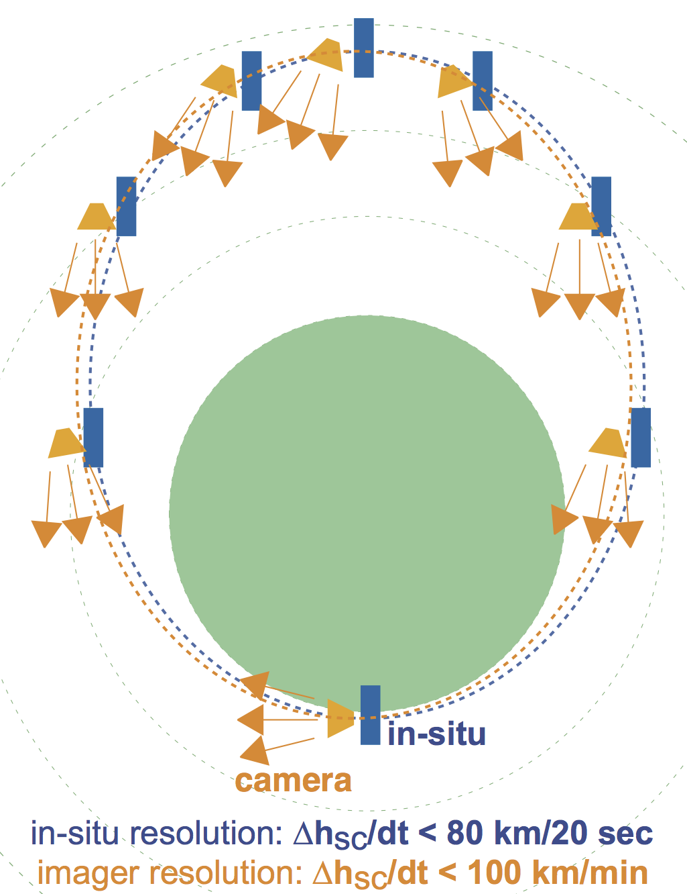
Terrestrial mission case (can copy for Venus/Mars)
Main (in-situ): payload 100-120 kg
Sub or despan platform (remote): payload 10-15 kg
Sub multi-point (in-situ) x 1 or 2: payload 5-10 kg
mandatory measurements | in-situ instruments
Neutral/Ion composition: | mass spectrometer (+ optical)
Tn (major species) | under development
Te and Ne | Langmuir probe
f(Vn) for N₂ and O | under development
Ion (major species) >10 eV | ion spectrometer
Electron | electron spectrometer
DC B (5m boom) | magnetometer
DC E (20 boom) | antenna
keep SC potential < 1V | potential control
important measurement
Ti (average) | Langmuir robe
Vi (average) | ion driftmeter
Vn (average) | accelerometer
Ion (major species) < 10 eV | cold ion spectrometer
ENA >10 eV | ENA
Energetic (> 10 keV) | solid-state detector
Cosmic ray (> 100 MeV) | wide angle telescope
Electric current | magnetometers
EM waves < 10 kHz | induction coil.

Slide 14
Earth mission case: Science closure
Science question | How can observations answer?
(A) re-distribution of incoming energy through ion-neutral interaction | By covering the energy distribution and macroscopic parameters (n, v, T) of both the background neutrals and ions, energy transfer can be measured on the distribution function level, e.g., whether a double-peak distribution is formed or not when the velocity is different between ions and neutrals under low collision frequency.
(A1) effect on long-term evolution | Measurement for (A) also tells the neutral heating and its variation, allowing us to calculate neutral-driven escape
(A2) thermosphere/exosphere | By combining remote measurements with (A), we can separate spatial-temporal structures including the layered structures and its variability
(A3) energy cascade in gradient | By adding extra measurement points using small sub-satellites to the above (A), we can evaluate the effect of the gradient
(A4) ion-neutral moment transfer | Measurement for (A) directly answers this

Slide 15
Key Points
Low-energy ion-neutral cross-section in space cannot be reproduced in laboratory (in quantitative sense).
Difficult conditions to achieve in laboratory are, (a) low-temperature (b) tenuous or strong gradient/layered (c) low-gravity plasma.
Minimum core package is about 10 kg, but measurements must be performed in MANY different extreme conditions (i.e., worth to be included in all L/M-class solar system object).
We can pursue this problem even Earth/Mars/Venus as one of the space condition, if we have proper measurements of small changes of environments (i.e., as M-class or F-class)

Slide 16
End

Slide 17
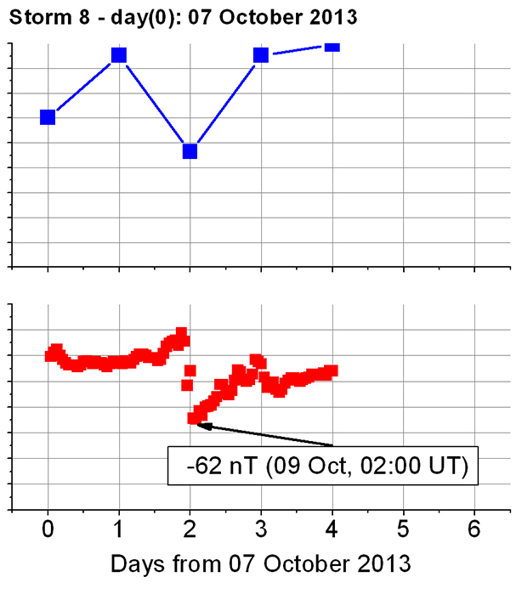
ex.1 (other examples)
(Zoennchen et al., 2017).
(Meier et al., 2015)
Relative variation in the column density of exospheric H (represented by total solar Ly-alpha flux in %) suddenly increases (decrease in Ly-alpha flux) when a large geomagnetic storm took place
Ratio of GUVI observation to the NRLMSIS empirical model at 194 km altitude and Mass density ratio (observation/model) at different altitudes from 143 km to 387 km

Slide 18
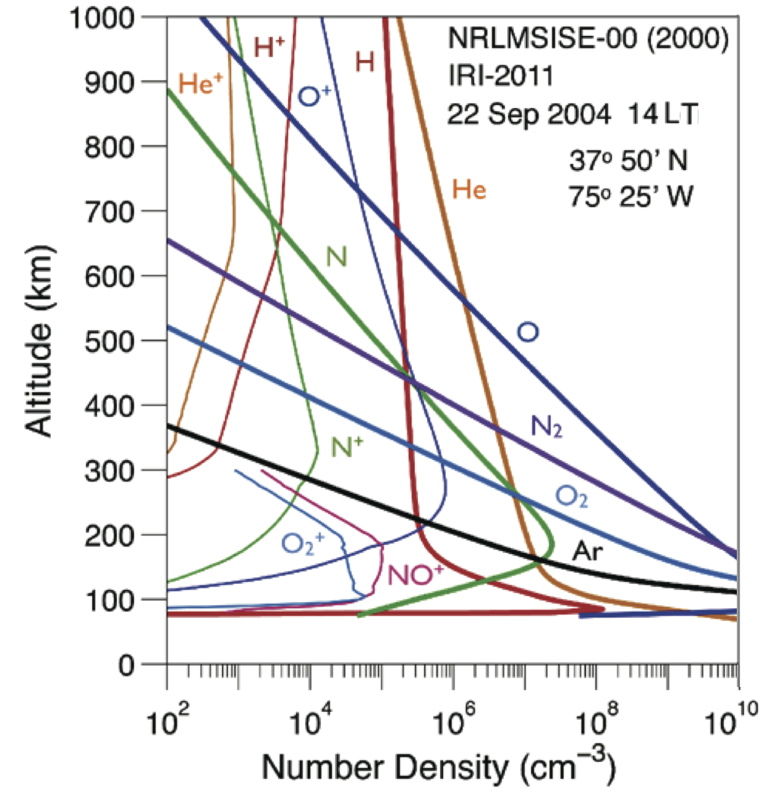
However, no modern measurement with composition > 300 km
Example altitude profile by the International MSIS model (Johnson, 1969; Pfaff, 2012). The smoothness of the profile (nearly exponential above 200 km for neutral species) comes from lack of observations.

Slide 19
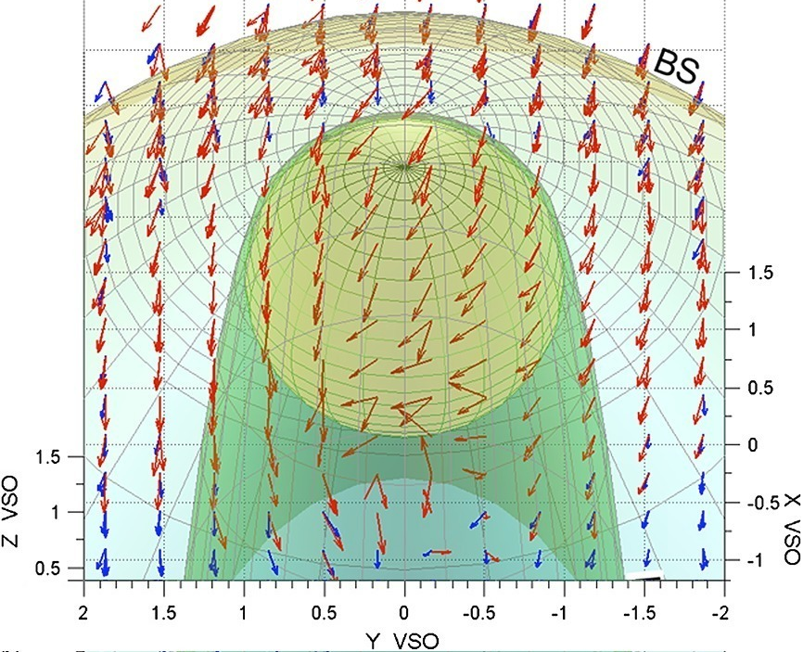
ex.2a Venus: Super-rotation
(Miller and Whitten, 1991)
(Lundin et al., 2013)
Pioneer Venus Orbiter found dawn-dusk asymmetry of cold ion convection in the super-rotation direction
VEX confirmed ion convection in the super-rotation direction with velocity 10 times faster.
Super-rotation in "stand-still" planet
⇒ (b) Momentum transfer is still mystery, suggesting higher ion-neutral momentum than model

Slide 20
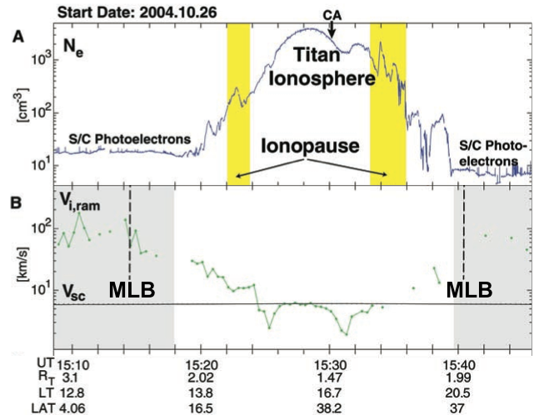
ex.2b Titan: cold ion escape
(Wahlund et a., 2005)
(Edberg et al., 2011)
Cassini found unexpectedly high density cold ions at the upper Titan ionosphere and subsequent high escape rate.
Fast cold ions flows in "stand-still" satellite
⇒ (b) Momentum transfer is still mystery, suggesting higher ion-neutral momentum than model

Slide 21
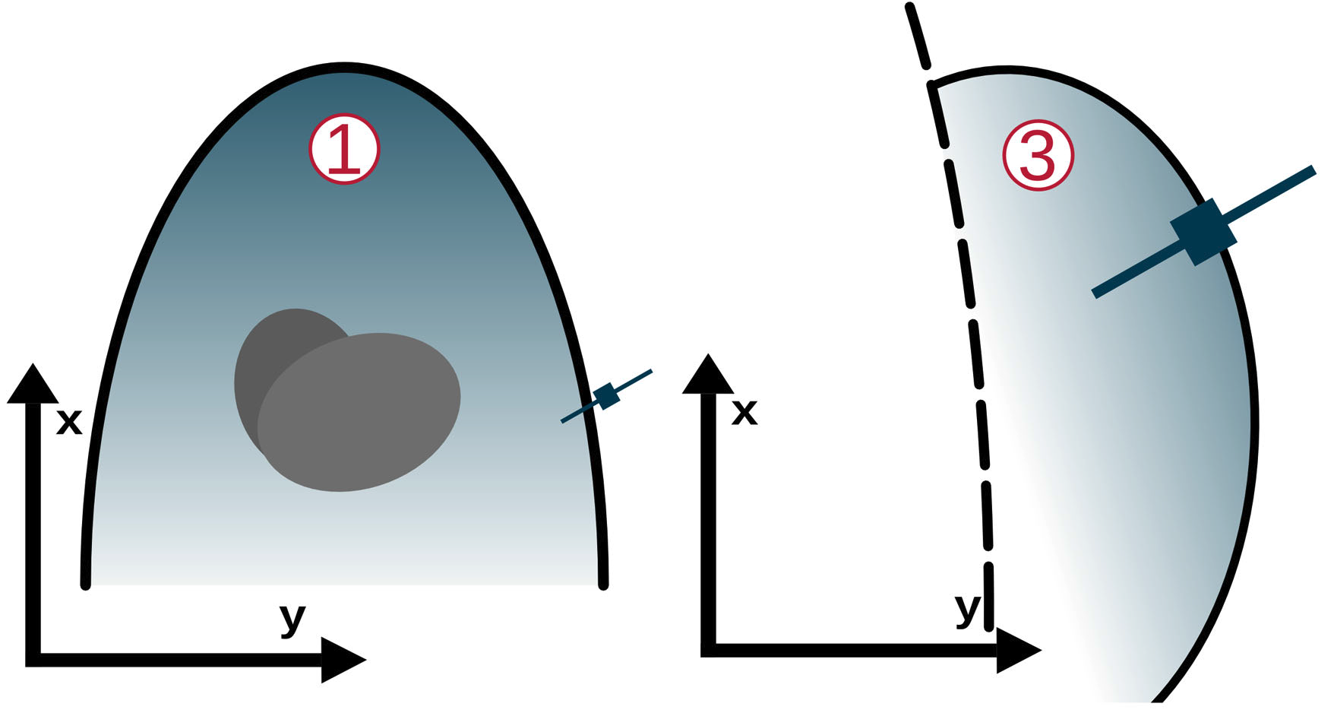
ex.3 Comet: unexpected structures in ion-neutral mixture
(Goetz et al., 2016)
The location and boundary normal direction suggest bubble-like rippling of the boundary.
Figure. Rosetta observations of magnetic cavity (magnetometer data).
This is commonly found, but unexpected not yet proper explanation using only ions and electrons
⇒ (c) Although it is comet "exosphere," influence of neutrals can be substantial, suggesting higher ion-neutral momentum than our knowledge

Slide 22
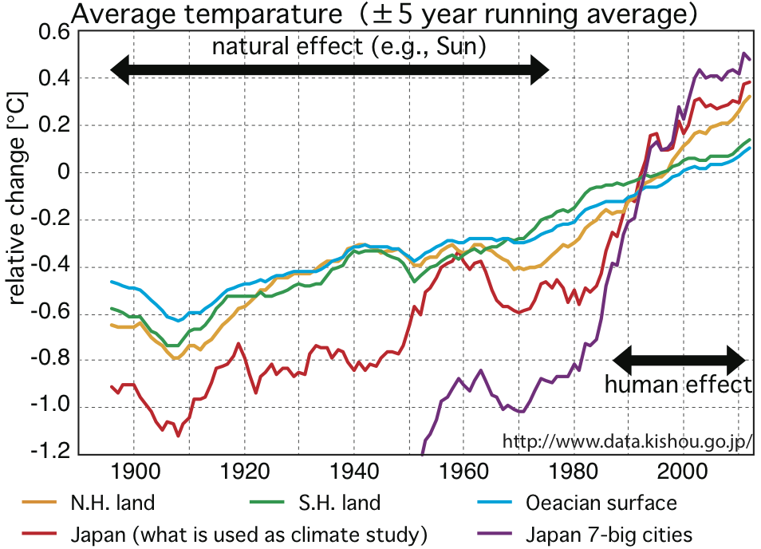
ex.4 solar influences: climate change
Blue: Length of sunspot cycle.
Red: Northern hemisphere average temperature
(Stauning, 2011)
Before human effect take over ~ 1980, solar cycle length and temperature are correlated
Ocean and south hemisphere lands started continuous increase from ~ 1980
Past temperature change (>10 year) is correlated with plasma/magnetic activity of the Sun before human effect take over
⇒ (d) but the mechanism that connect plasma and neutral atmosphere is not known, and we need to know the ion-neutral interaction in the upper atmosphere

Slide 23
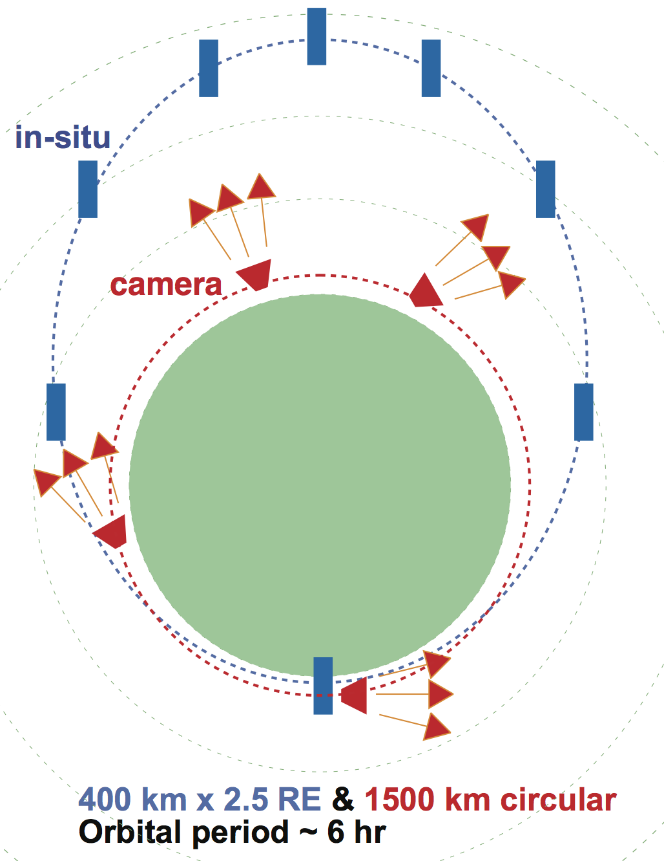
Terrestrial mission case (can copy for Venus/Mars)
Main (in-situ): payload 100-120 kg (dry mass 350 kg/200 W)
Sub/despan platform (remote): payload 10-15 kg (dry mass <60 kg)
Sub multi-point (in-situ) x 1 or 2: payload 5-10 kg (day mass <30 kg)
Main (in-situ):
Different orbit (remote):
Sub milt-point (in-situ) :

Slide 24
Earth mission case: Advantage of ground support
Incoherent scatter (IS) radars: monitor of electron temperature, electron density, ion temperature, and line-of-sight ion velocity at different altitudes nearly simultaneously.
EISCAT_3D: Next generation IS radar to cover a large 3D volume of space in very short time.
SuperDARN: Global network of HF radars that provide line-of-site velocity in a wide region in Earth's upper atmosphere and ionosphere. Although the detection altitude is lower than 150 km altitude, this gives important information on the plasma motion.
Fabry–Pérot interferometer: Neutral motion and temperature at around 240 km where the airglow emission is maximized altitude, using optical interferometry measurement of the Doppler spectrum. Although this altitude is lower than target region, this gives another important information on the neutral motion.
Scanning Doppler Imager (SDI): Capable of measuring 2D wind and temperature field from a snap shot of the all-sky image.
Magnetometers: Traditional global network that support the ionospheric dynamic and electric current
OH airglow imager: Monitor of upper mesosphere-lower thermosphere temperature.

Slide 25
Requirement for the spacecraft
• Cold Xenon propulsion is preferable for orbit maneuvers or attitude control to avoid propulsion that contains nitrogen (N) or propane (C₃H₈)
• External conductive surfaces, together with active spacecraft potential control.
• The required pointing accuracy is 1° (0.1° knowledge) for both the main spacecraft and the remote sensing sub-spacecraft.
• A Sun-pointing constant attitude (minimum outgass).
• All particle instruments with unobstructed FOV (minimum blockage)
A similar mission could be devised for Venus. In that case, some on-board processing of the data before sending to the Earth would be needed.

Slide 26
Technological Challenges
Instrument
Develop a new instrument to (a) measure the temperature of the background neutral gas for at least two major components except H (e.g., N₂ and O with accuracy for 10 sec integration for Earth/Venus), (b) measure variation of temperature: ∆T=300K (or 30% for heated events with >1000K).
Develop a new instrument to measure the 2D-velocity distribution of background neutrals for at least two major components except H (e.g., N₂ and O ), with 10% sensitivity compared to the Maxwellian peak.
Improve the old instrument or newly develop an instrument to measure the velocity and energy distribution of the background cold ions.
Improve the low energy ENA for < 100 eV toward high angular resolution to estimate of the substantial cross section, for which our knowledge even in laboratory is poor.
Spacecraft
Autonomous maneuver using sun-sensor should be developed to keep to cost low (otherwise need everyday to keep sun-alignment < 1°).
Another autonomous system for radiation belt detection using the on-board data (energetic particle detector and background noise in MCP) combined with a radiation belt model and space weather predictions.

