Slide 1
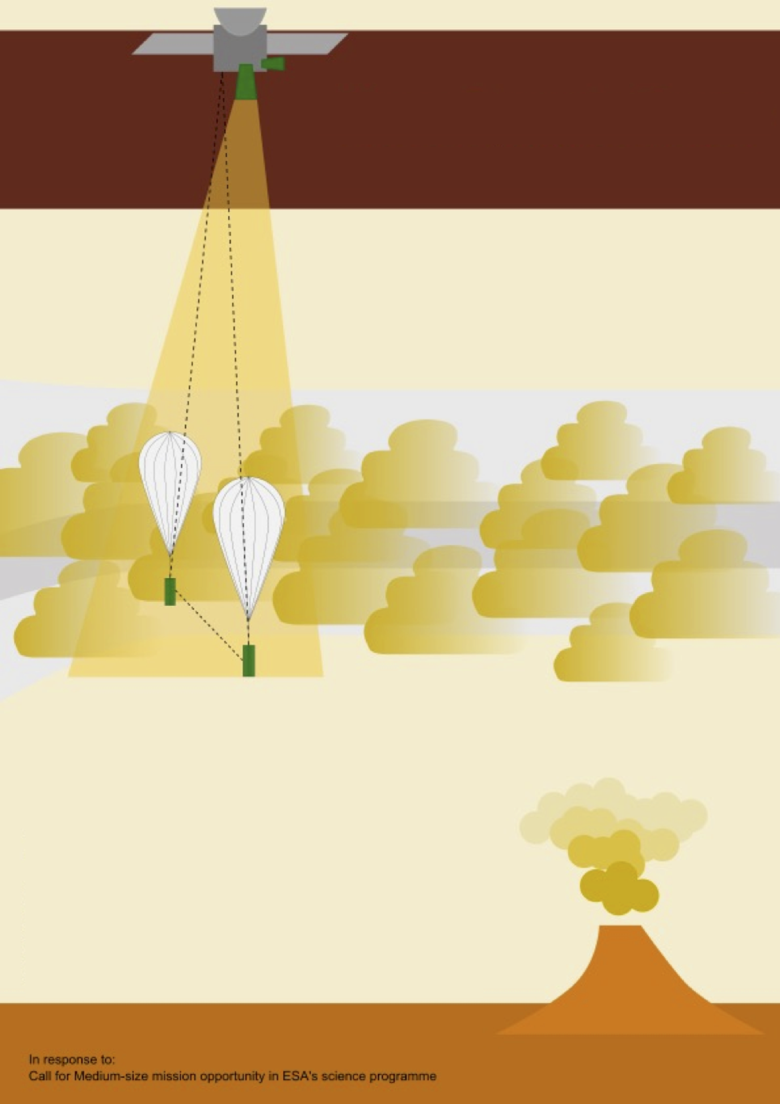
VdT
1. Main Science Target
How is the absorbed solar radiation energy re-distributed into other forms of energy for non-rotating planets?
Venus Dynamics Tracer
(VdT)
internal (temp., latent heat, chemical)
kinetic (wind, eddy, wave, ion-neutral)
electric (ionization, lightning)
2. What must be measured
local process (in-situ)
3D motion (in-situ + remote sensing)
⇒ We need multiple balloons
G. Stenberg-Wieser¹, M. Yamauchi¹,
M. Persson², and VdT proposal team
Swedish Institute of Space Physics, Kiruna
GSFS, University of Tokyo, Kashiwa
3. Science Case for VdT
Super-rotation (cloud & ionosphere)
Effect of mountain wave at > 45 km
ion ↔ neutral energy exchange
ST1.4/vSP.5 (Thursday, 2023-4-27)

Slide 2
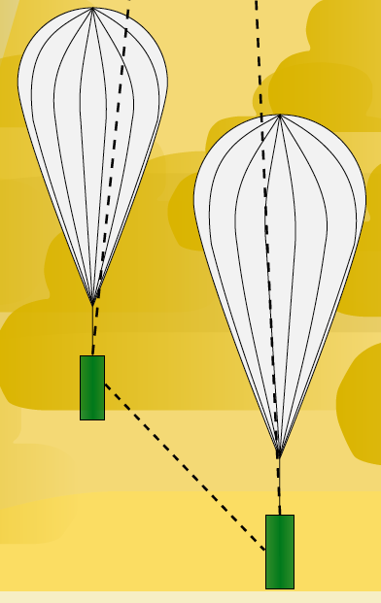
Advantage of two near-by balloons
Can Measure
Divergence
Shear
Gradient
Can derive
Local energy budget
Momentum/Heat transfer
Wave vs Convection
Will investigate
Role of solar tides
Role of vertical wind
Interaction between the atmosphere and the surface (mountain wave)
2

Slide 3
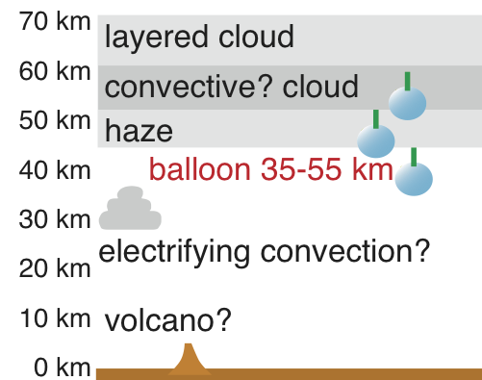
(1) Cloud dynamics/thermodynamics
Energy input:
Visible light
Super-rotation, Mountain wave, other structures
  Roles of the vertical and meridional (i.e., 3D) circulation?
  Roles of latent heat?
  ⇒ separation of wave and motion requires ≥2 balloons
ref: Thermal tide for cloud super-rotation: Horinouchi et al. (2020) 10.1126/science.aaz4439
Thermal convection above cloud: Sánchez-Lavega et al. (2017) 10.1007/s11214-017-0389-x

Slide 4
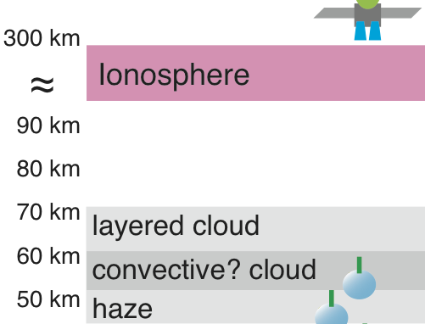
(2) Ionospheric/themospheric dynamics
Energy input: EUV
momentum coupling?
Dawn-dusk asymmetry of ions (& neutrals) wind @ ionosphere
  How much does the thermospheric thermal tide drive the dynamics?
  How much does the atmospheric super-rotation affect
  How much does external forces on ions (e.g., solar wind) contribute?
ref: PVO observation: Miller and Whitten (1991) 10.1007/978-94-001-3500-5_3
MEX observation: Lundin et al (2011) 10.1016/j.icarus.2011.06.034

Slide 5
Mission Profile
Baseline : Two Balloon probes
1. Entry module (⇒ most challenging technology for ESA)
1. Aero-breaking to ease the entry temperature ?
1. Decent and inflation sequence similar to the VEGA missions
1. Balloon altitudes: 50-55 km and below 50 km
1. Diameter of Ø≥4.3m + gondra (payload ≈ 5 kg) ⇒ 20 days mission phase
1. Direct communication to the Earth at inflation
Nominal: + Orbiter
2. Small orbiter with 15-40 kg payload at > 400 km with dives to < 180 km
2. Piggy-back of ("ejected" from) the entry module
2. Additional telemetry for balloons
Extra: + 3rd N₂ gas-filled balloon
3. Low buoyancy but long flight (low leak of balloon gas)
5

Slide 6
Mission element
Balloon payload
Core:
- Balloon location (telemetry): most important
- Temperature and Pressure
Precision:
- Humidity
- Heat flow/thermal conductivity
- Relative wind
Global context:
- Lightning (remote turbulence)
Orbiter payload
Core:
- Balloon location (telemetry)
- Wind at balloon altitude (NIR)
- Neutral wind and ion wind
Global context:
- Wind at higher altitude than balloon (IR camera)
- Monitoring camera (UV)
Precision of global context:
- Altitude profiles of electron density & pressure (occultation)
- Secondary IR camera

Slide 7
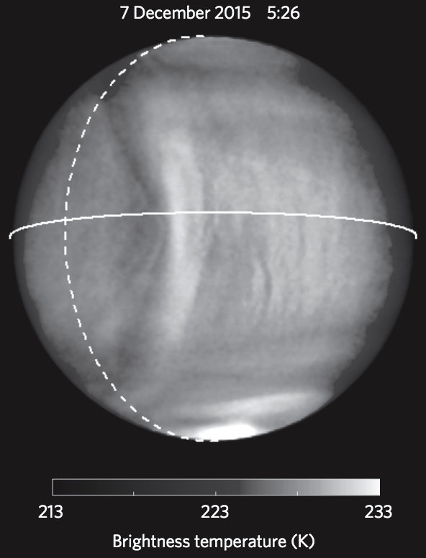
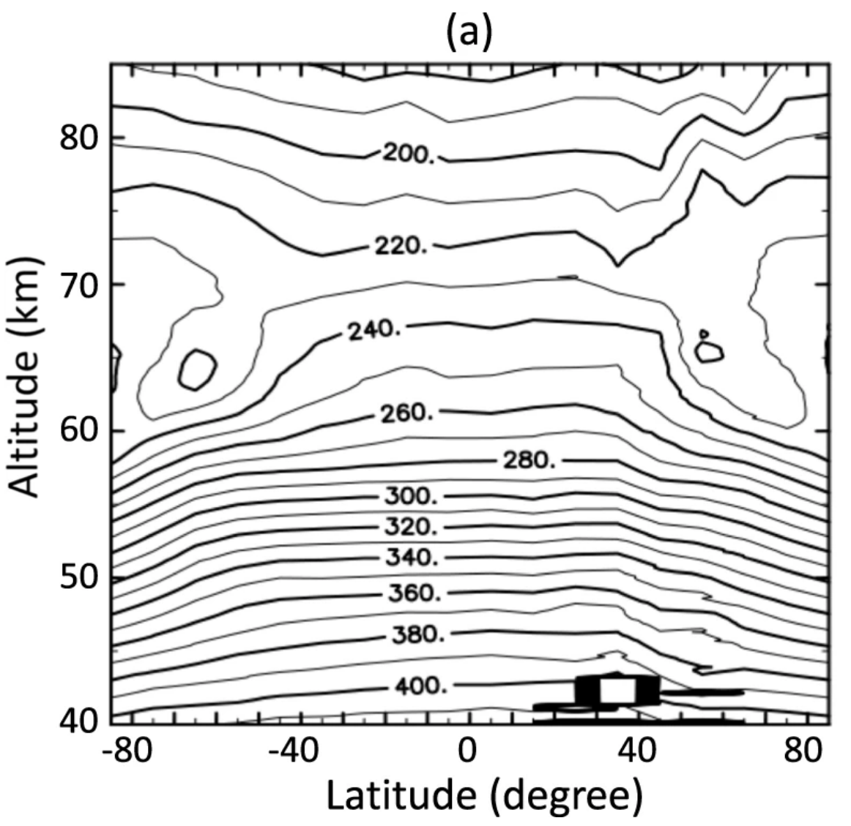
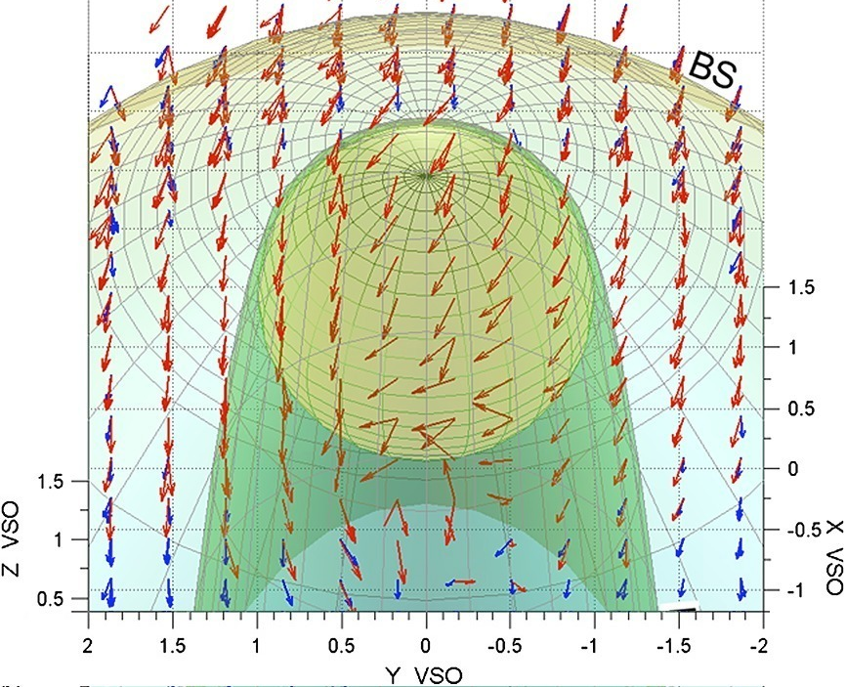
Examples of complex lat./long. structure
Mountain wave
Temperature
Example of asymmetry
hot ion bulk velocity
Fukuhara et al. 2017 (Akatsuki)
Ando et al. 2020 (Akatsuki)
Lundin et al 2013 (VEX)

