Slide 1
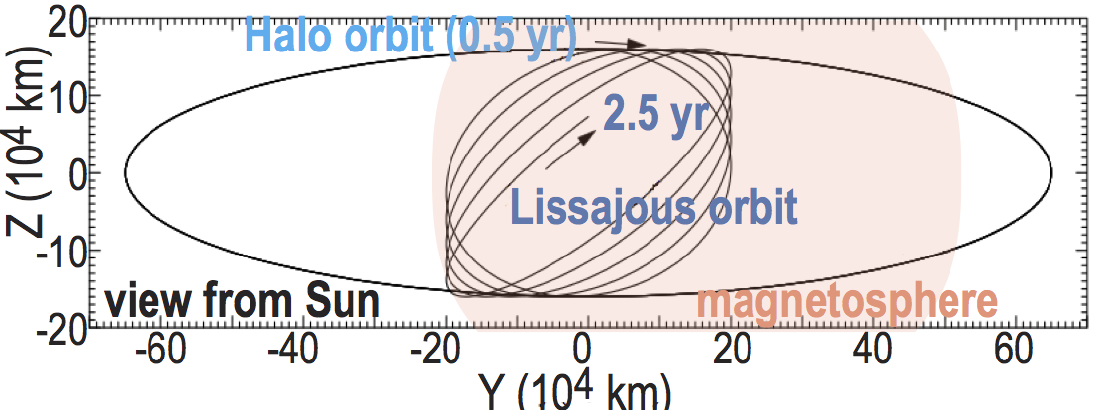
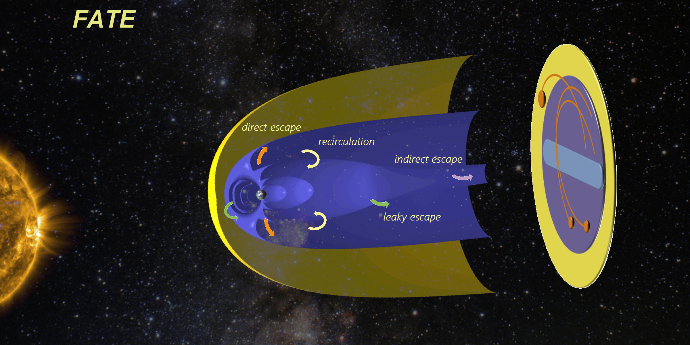
FATE: Far Tail Explore
(ESA F1 proposal)

Slide 2
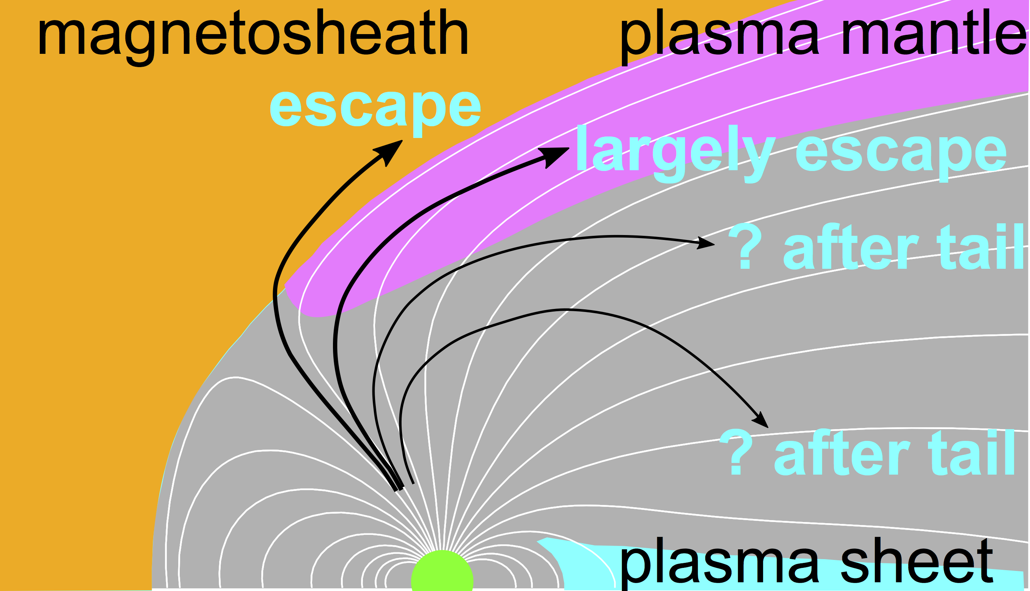
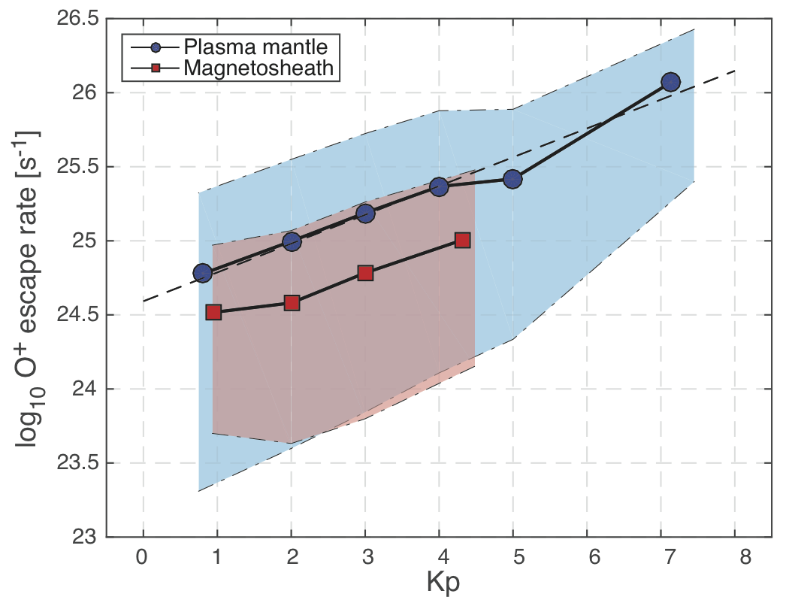
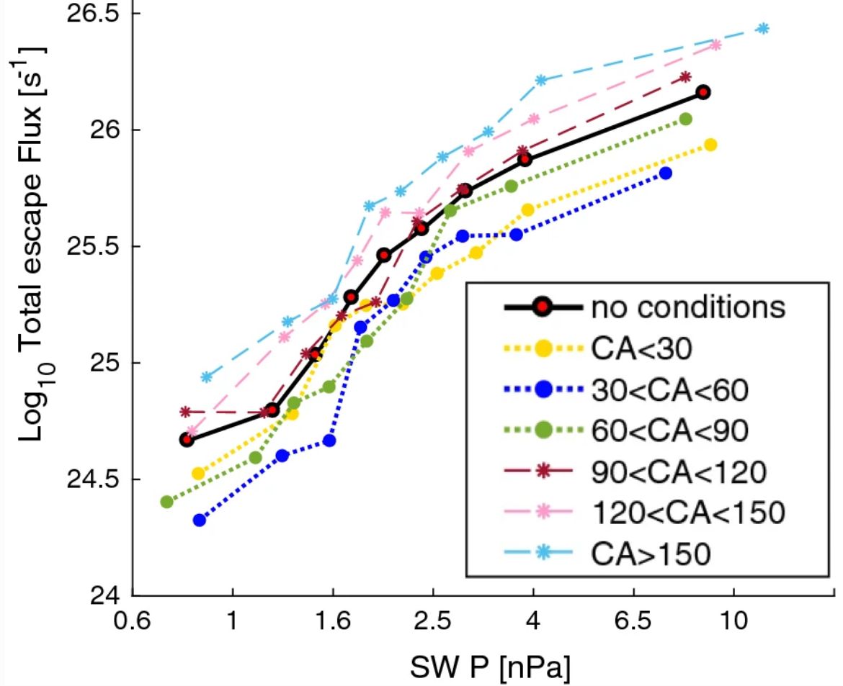
Science 1: Ion escape from the Earth
Ancient solar forcing (young M-stars)
(a) much higher EUV flux than present
(b) faster solar wind than present
(c) much faster rotation than present
⇒ stronger solar dynamo
⇒ stronger flare / CME / SEP (Solar Energetic Particle)
10²⁶
10²⁵
10²⁴
⇒ Kp=10 or P_{SW}=100 as proxy of the past
Loss rate : ∝ exp(0.45*Kp)
or ∝ P_{SW}^{2.5}
(Slapak et al., 2017)
Kp=1
Kp=7
⇒ We expect 10²⁷ s⁻¹ for only this route
(Schilling et al., 2019)
⇒ 3·10⁴³ O⁺ over 1 Gyr (3·10¹⁶ sec)
= 70% of present atmospheric O₂ (15% of N₂)
10²⁶
10²⁵
10²⁴
cf. Observed O/N ratio fluctuate in 0.1 byr : not easy to explain by bioactivity

Slide 3
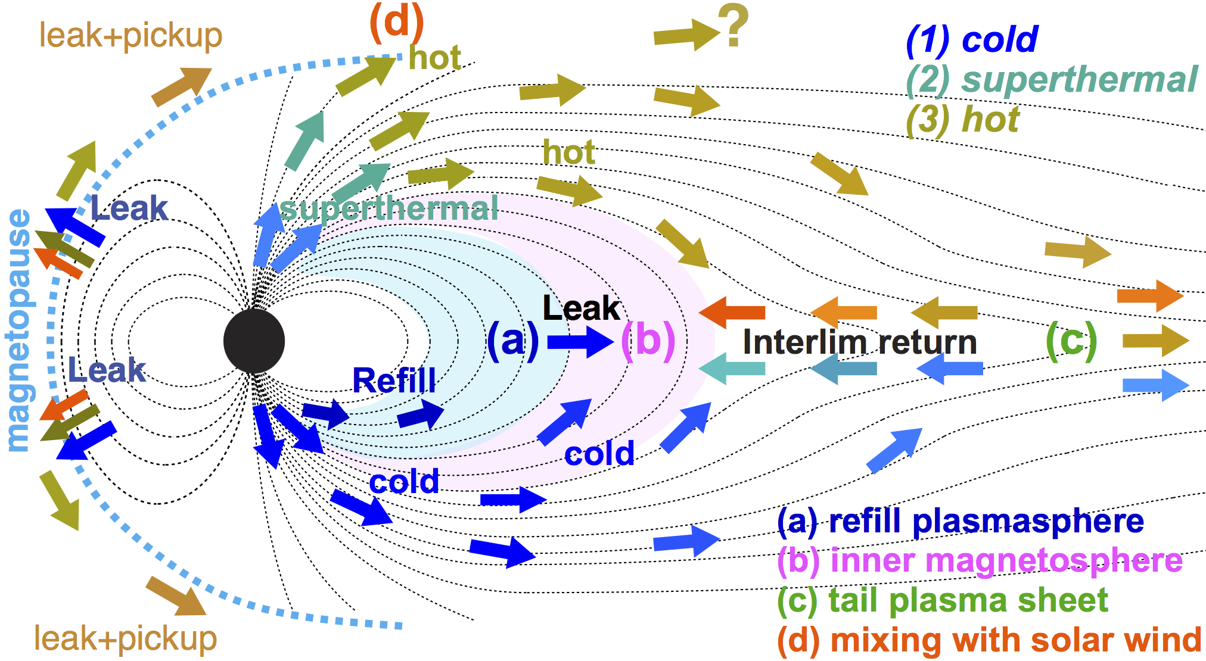
All ions should go to L2
O⁺ ~ 10²⁵⁻²⁶ s⁻¹
O⁺ ≤ 10²⁴ s⁻¹
O⁺ ≤ 10²⁵ s⁻¹
O⁺ ≤ 10²⁵ s⁻¹
O⁺ ≤ 10²⁴ s⁻¹

Slide 4
Escapes mechanisms
mechanism | explanation | Where?
Jeans escape | Thermal tail exceeds the escape velocity | exobase (M, ancient E?)
Hydrodynamic blow off | Massive escape when thermal energy exceeds escape energy | near exobase (ancient)
Momentum exchange | Light neutrals collide with heavy molecules | above exobase (M, ancient E/V?)
Photochemical energization | Recombination etc. supply the escape energy | exosphere (M, ancient)
Charge-exchange | Trapped ion with escape velocity strives an electron from neutral | above mirror altitude (E)
Atmospheric sputtering | Precipitating heavy ions (pickup or trapped ones) impact the atmosphere | around and above exobase (M, V>E)
Ion pickup | Cold ions that are newly exposed to solar wind are removed by the solar wind ExB | outer exosphere (M>V, ancient E?)
Ions accelerated by field reach SW | E// acceleration (DC field) and wave-particle interactions (AC field). | ionosphere & magnetosphere (E>M>V?)
Large-scale momentum transfer & instabilities | Solar wind P_{Dynamic} and EM forces push the planetary plasma anti-sunward. | magnetospheric boundary and tail (E>M, V)
Magnetopause shadowing (ions) | The drifting ions overshoot the magnetospheric boundary. | inner magnetosphere (E)
Plasmaspheric wind and plumes | Detachment or expansion of cold plasma by instability or pressure | plasmasphere (E)
neutrals
both mixed
ions

Slide 5
Main escape mechanism for the Earth
mechanism | present Earth | ancient Earth?
Jeans escape | - | yes? (need to understand present exosphere)
Hydrodynamic blow off | - | yes? (need to understand present exosphere)
Momentum exchange | - | yes? (need to understand present exosphere)
Photochemical energization | - | yes
Charge-exchange | yes | ? (need to understand ring current)
Atmospheric sputtering | - | yes? (need to understand past cusp)
Ion pickup | - | yes
Ions accelerated by field reach SW | YES ! | yes
Large-scale momentum transfer & instabilities | yes | yes? (need to understand past magnetosphere)
Magnetopause shadowing (ions) | yes | yes? (need to understand past ring current)
Plasmaspheric wind and plumes | yes | yes? (need to understand past plasmasphere)
neutrals
both mixed
ions
Mission for only ion
⇒ can be downstream
To understand both ion and neutral, low perigee elliptic orbit is needed
⇒ ESCAPE

Slide 6
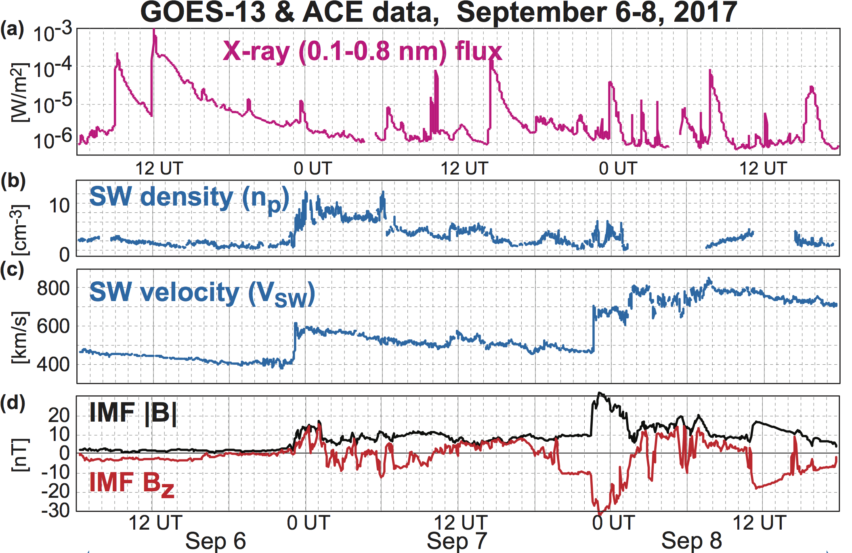
Science 2: Space Weather
CME is along the solar wind, but not Solar Energetic Particles (SEP)
1st SEP/CME
2nd SEP/CME

Slide 7
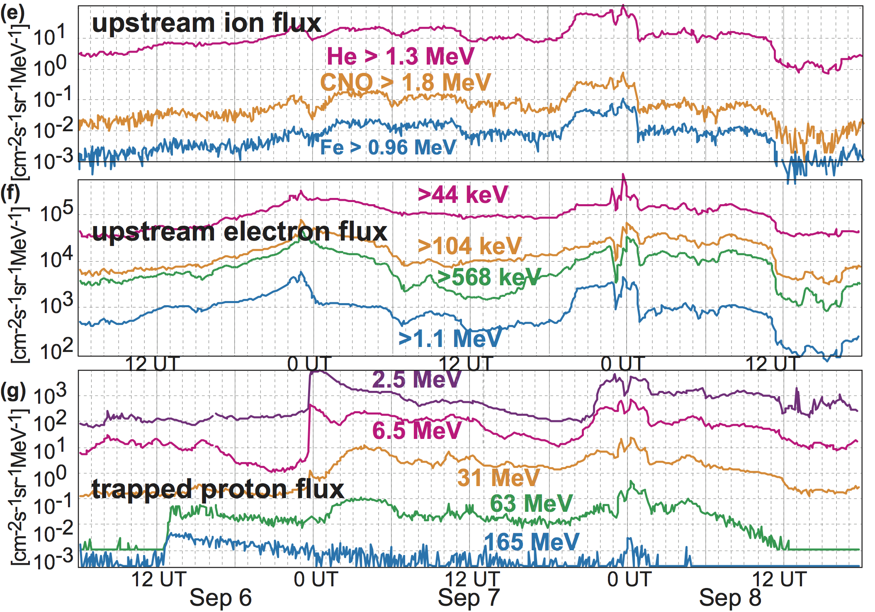
CME is along the solar wind, but not SEP
1st SEP/CME
2nd SEP/CME

Slide 8
CME is along the solar wind, but not SEP
L1 obs ≠ Geosynchronous
SEP flow along B rather than along SW
⇒ Space Weather does not protect space telescope at L2
& L1 + L2 combined data must be compared to GOES data
⇒ Solar wind + SEP monitor at L2

Slide 9
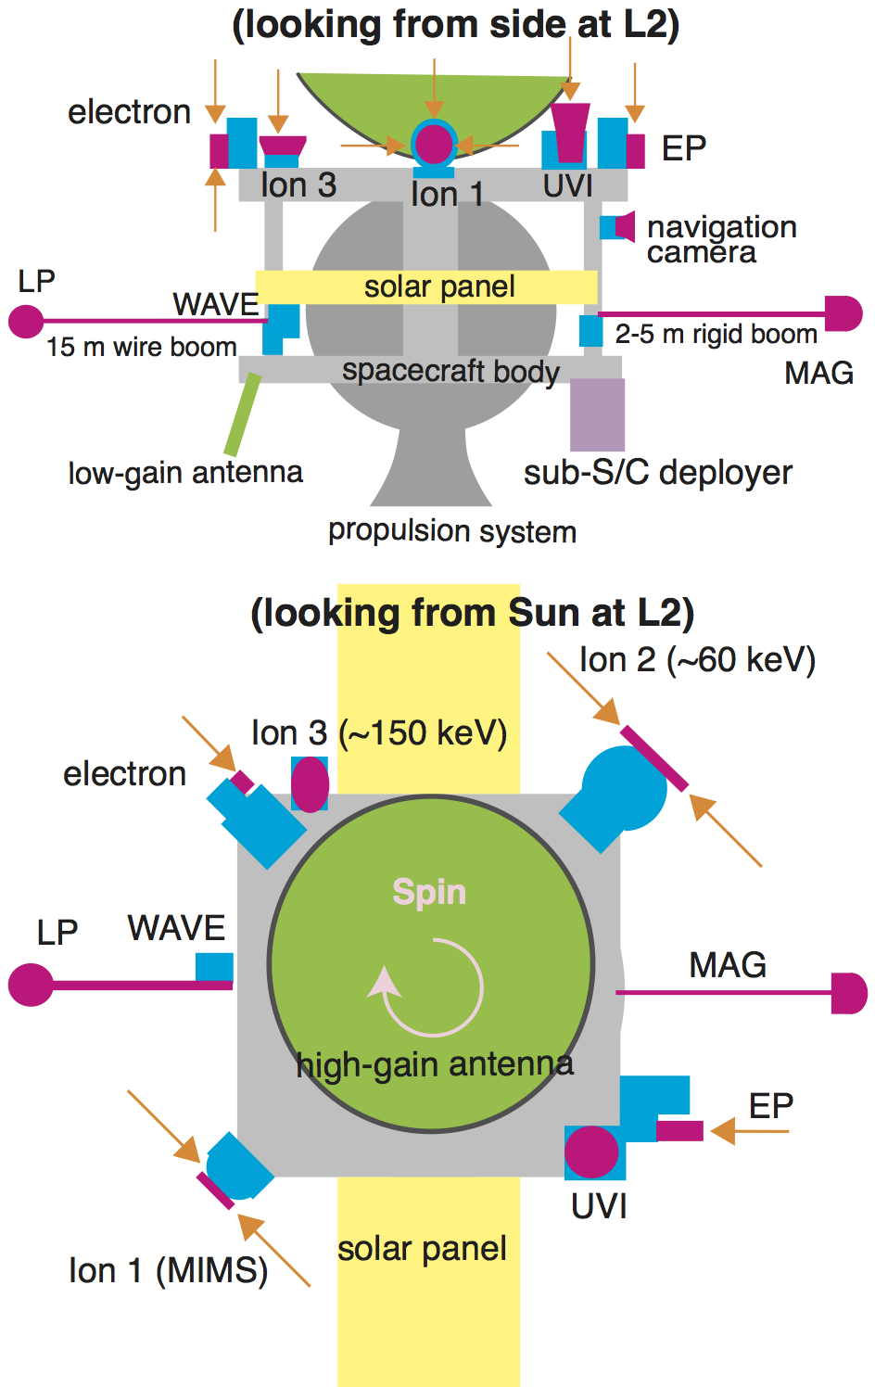
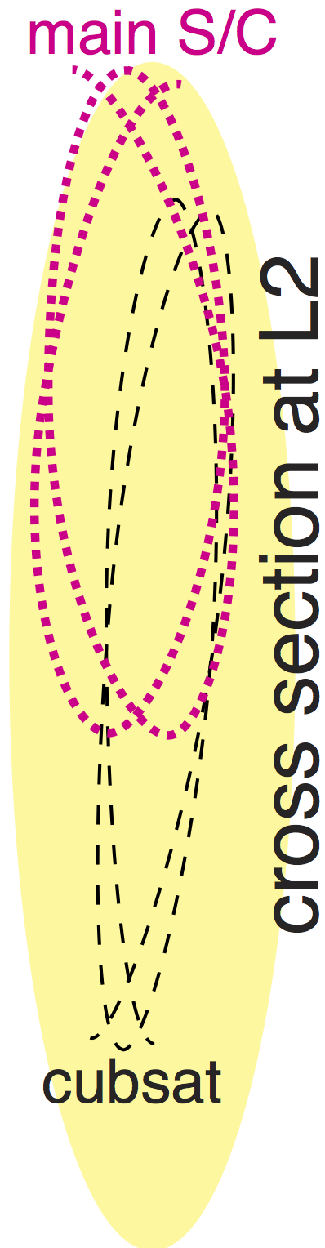
FAr Tail Explorer (FATE)
One mother (left) + two 6U cubesat
MCP-type ion up to 60 keV = 850 km/s O⁺
Good mass resolution up to 30 keV
SSD-type ions above
Minimum field package
The cubesat is equipped
MCP type ion mass for 0.1-20 keV
SSD-type ions for 15-85 keV = 1000 km/s O⁺
One more (LP or B)
(1) obtain the total ion escape and variability,
(2) identify the relative importance of the different ion escape routes
(3) more accurate space weather warning
(4) study fine-scale magnetospheric boundary far downstream

